Slide 1
Angular 2 Intro

Slide 2
Why to use HTML5 frameworks
•
Deal with cross-browser compatibility
•
Make your application more structured
•
May include reusable components
•
Make programmers more productive
•
Lower the amount of manually written code

Slide 3
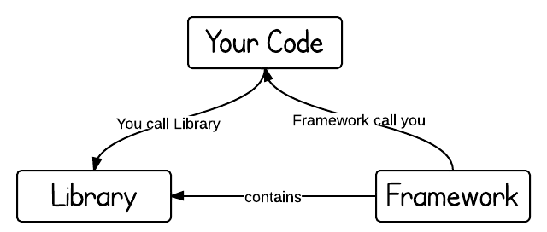
Frameworks and Libraries
Frameworks expect you to develop using well
defined rules.
Libraries just offer reusable components

Slide 4
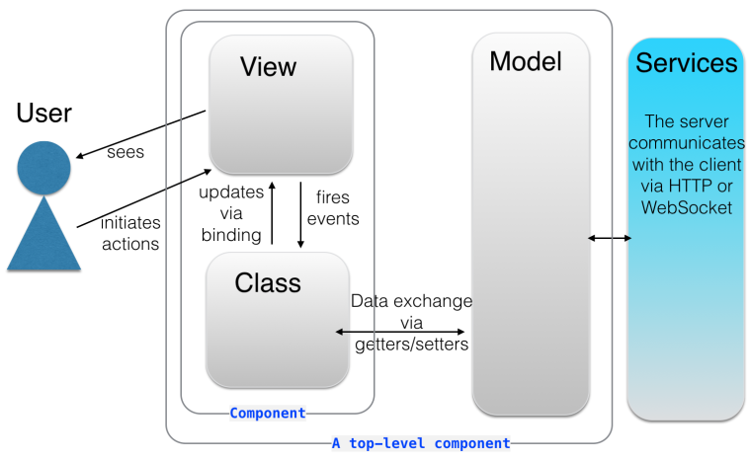
MVC model
Notes:
http://www.codeproject.com/Articles/869712/AngularJS

Slide 5
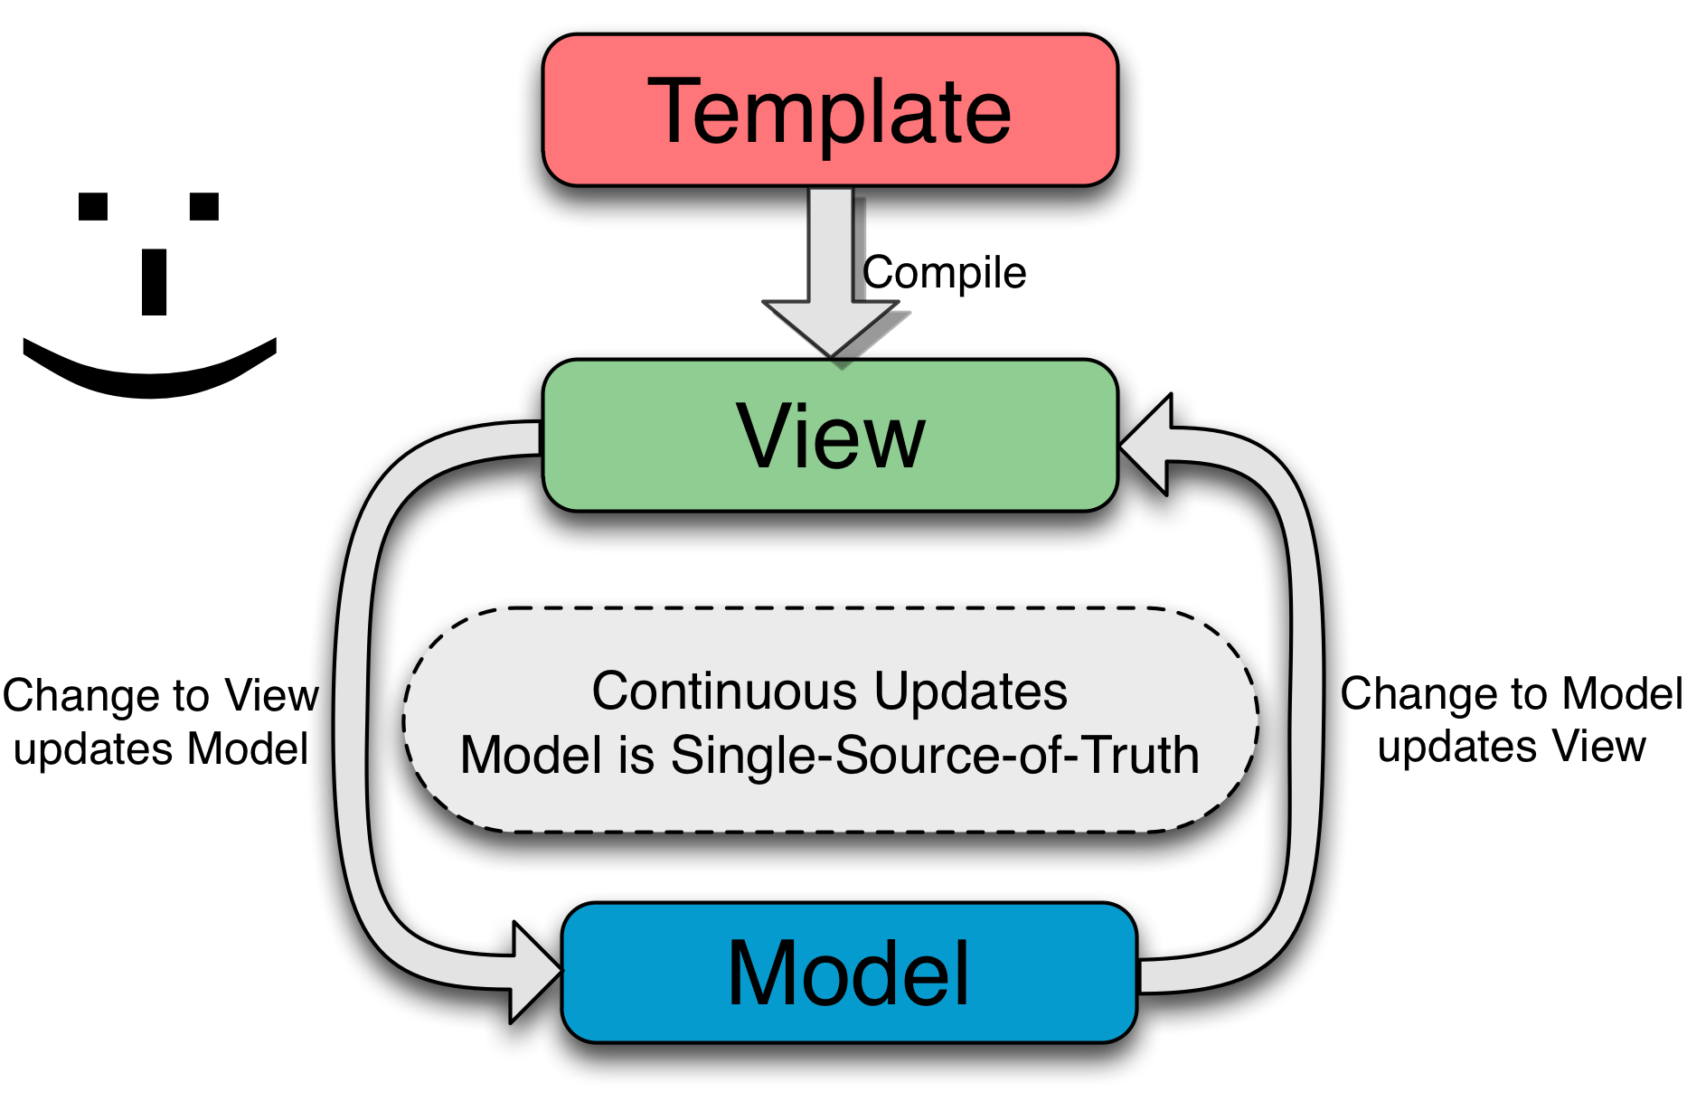
Two-way data binding
Notes:
AngularJS' two-way data-binding handles the synchronization between the DOM and the model, and vice versa

Slide 6
Two way data binding example
MODEL
VIEW
Name:
John Smith
name="John“;
ngModel="name"
VIEW
MODEL
Name:
John
ngModel="name"
name=="John Smith";

Slide 7


Slide 8


Slide 9
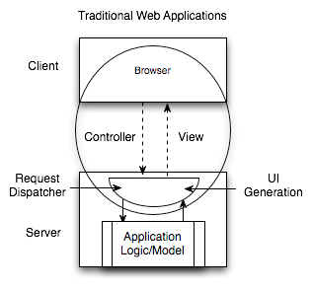
Why use a JS MVC framework
Poor distribution of processing – With a large number of clients, doing all the processing on the server is inefficient.
High user response latency
Difficult programming model
Increased vector of attack
Heavy state management on the servers
Offline Difficulties
Reduced opportunity for interoperability
Notes:
Poor distribution of processing – With a large number of clients, doing all the processing on the server is inefficient.
High user response latency – Traditional web applications are not responsive enough. High quality user interaction is very sensitive to latency, and very fast response is essential.
Difficult programming model – Programming a user interface across client/server is simply difficult. When every interaction with a user must involves a request/response, user interface design with this model is complicated and error prone. The vast number of web frameworks for simplifying web development testifies to this inherent difficulty. Some have mitigated this difficulty to some degree.
Increased vector of attack – Unorganized mingling of user interface code with business code can increase security risks. If access rules are distributed across user interface code, as user interface code grows and evolves, new vectors of attack emerge. With mixed code, new user interface features can easily create new security holes.
Heavy state management on the servers – When client user interface state information is maintained by the server, this requires a significant increase in resource utilization as server side sessions must be maintained with potentially large object structures within them. Usually these resources can’t be released until a session times out, which is often 30 minutes after a user actually leaves the web site. This can reduce performance and scalability.
Offline Difficulties – Adding offline capabilities to a web application can be a tremendous project when user interface code is predominantly on the server. The user interface code must be ported to run on the client in offline situations.
Reduced opportunity for interoperability – When client/server communication is composed of transferring internal parts of the user interface to the browser, it can be very difficult to understand this communication and utilize it for other applications.

Slide 10
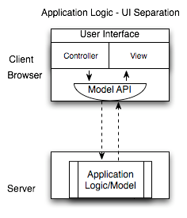
Why use a JS MVC framework
JSMVC Web Applications
Scalability - The more clients that use an application, the more client machines that are available, whereas the server processing capabilities remain constant
Immediate user response
Organized programming model
Client side state management
Offline applications
Interoperability
Notes:
Scalability – It is quite easy to observe the significant scalability advantage of client side processing. The more clients that use an application, the more client machines that are available, whereas the server processing capabilities remain constant (until you buy more servers).
Immediate user response – Client side code can immediately react to user input, rather than waiting for network transfers.
Organized programming model – The user interface is properly segmented from application business logic. Such a model provides a cleaner approach to security. When all requests go through user interface code, data can flow through various interfaces before security checks take place. This can make security analysis more complicated, with complex flows to analyze. On the other hand, with a clean web service interface, there is well-defined gateway for security to work on and security analysis is more straightforward, holes can be quickly found and corrected.
Client side state management – Maintaining transient session state information on the client reduces the memory load on the server. This also allows clients to leverage more RESTful interaction which can further improve scalability and caching opportunities.
Offline applications – If much of the code for an application is already built to run on the client, creating an offline version of the application will almost certainly be easier.
Interoperability – By using structured data with minimal APIs for interaction, it is much easier to connect additional consumers and producers to interact with existing systems.

Slide 11
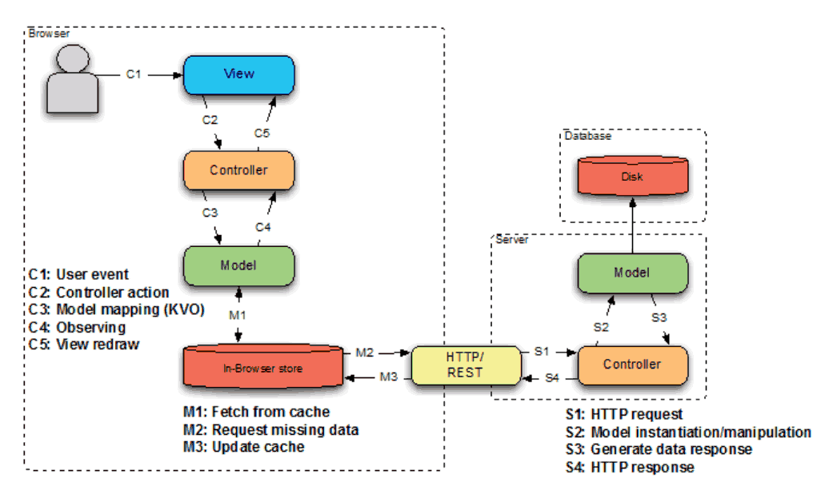
Data Flow for modern web development

Slide 12
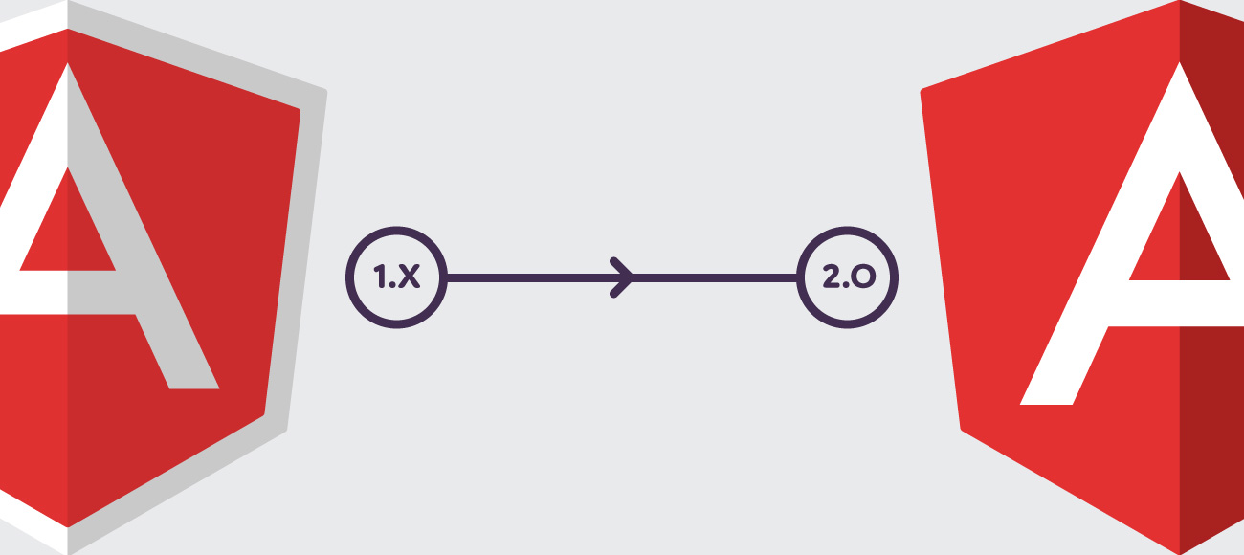

Slide 13


Slide 14
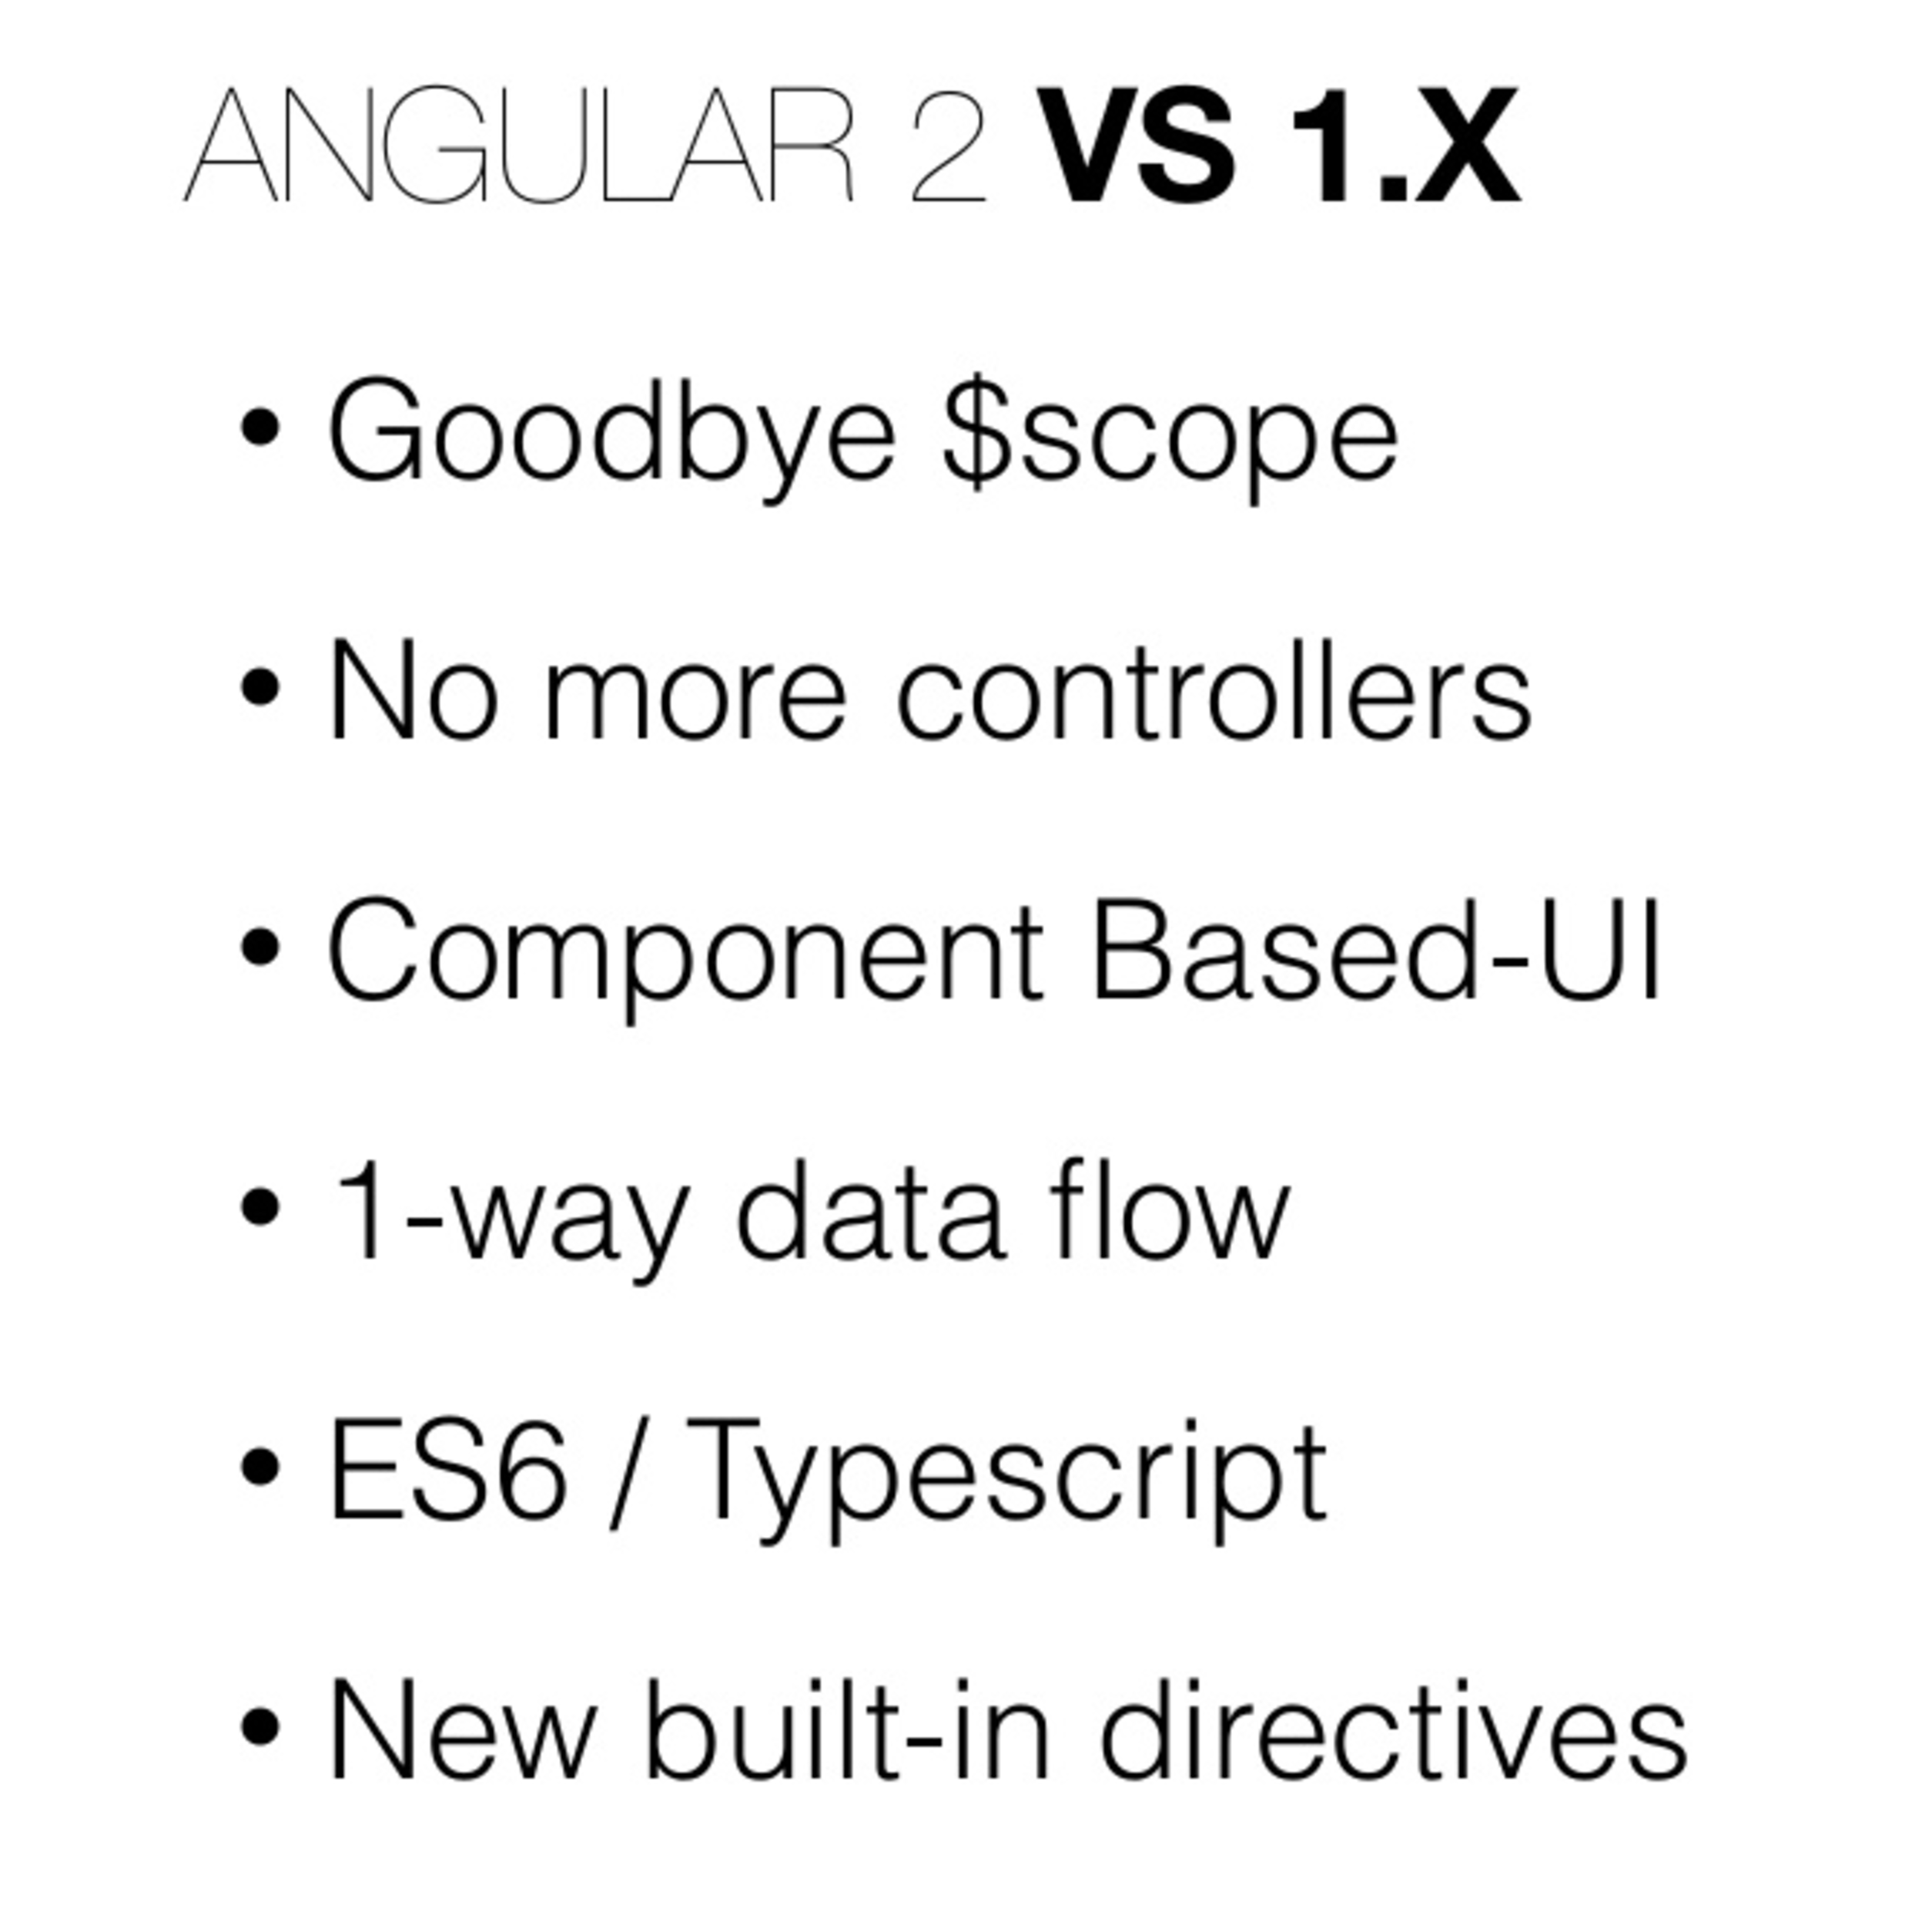

Slide 15
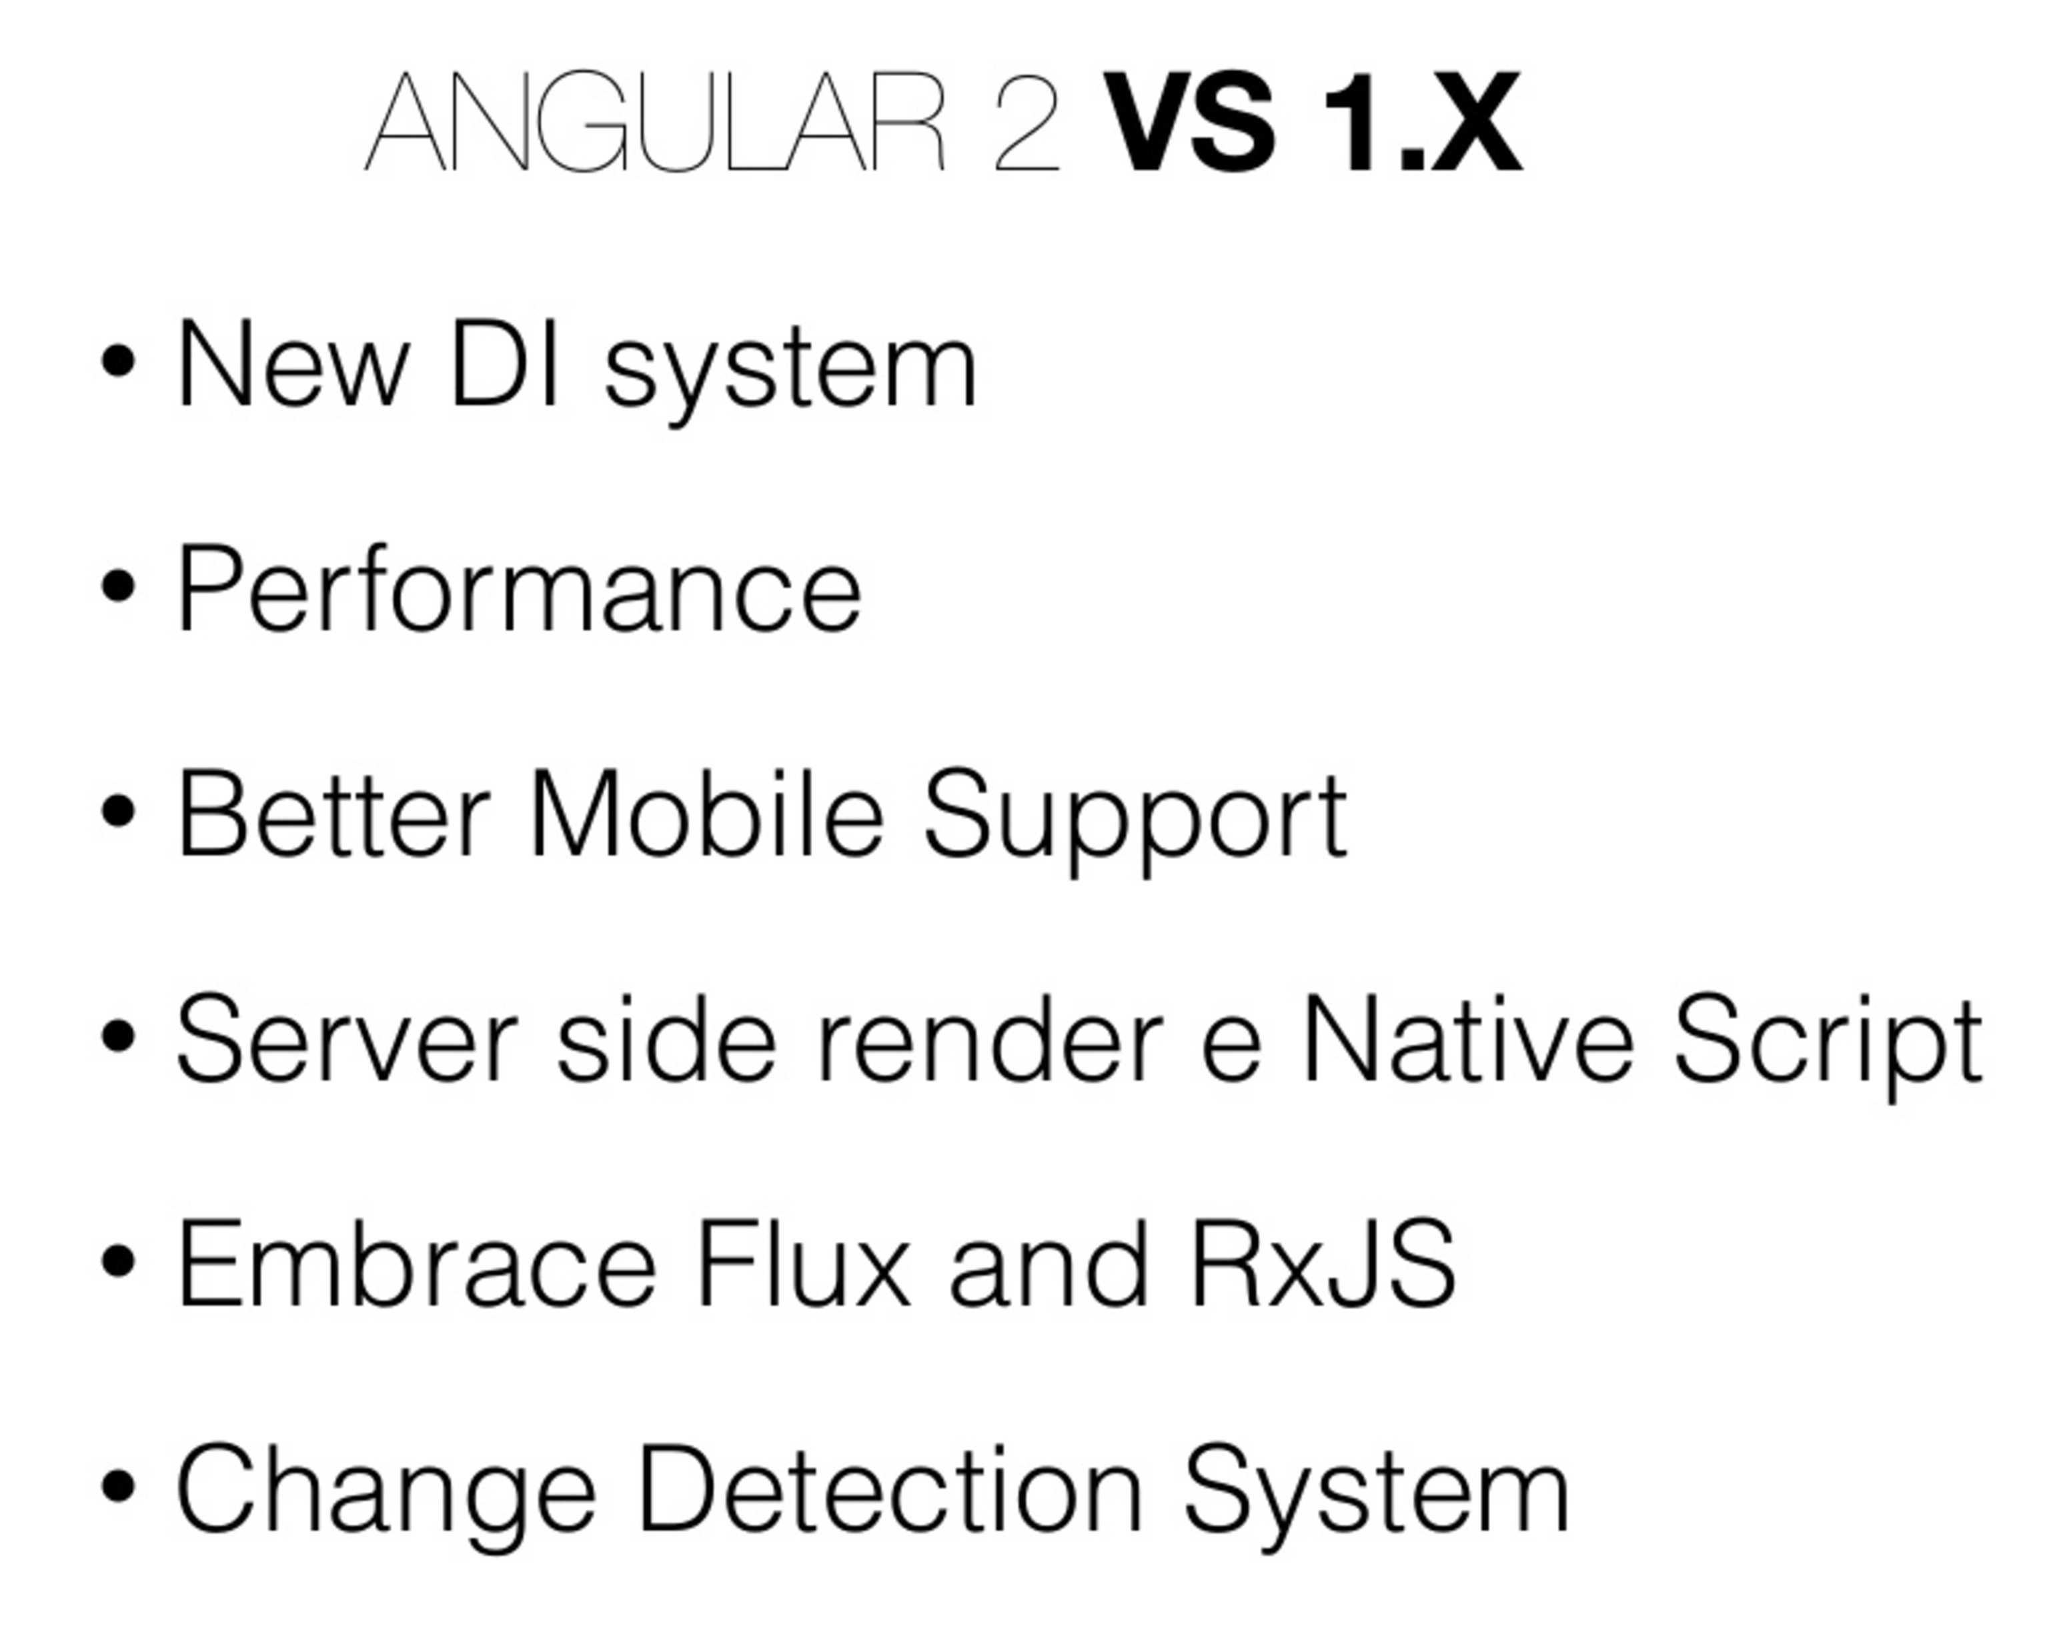

Slide 16
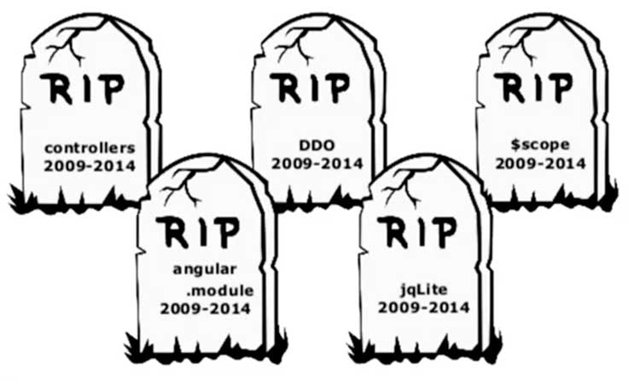

Slide 17
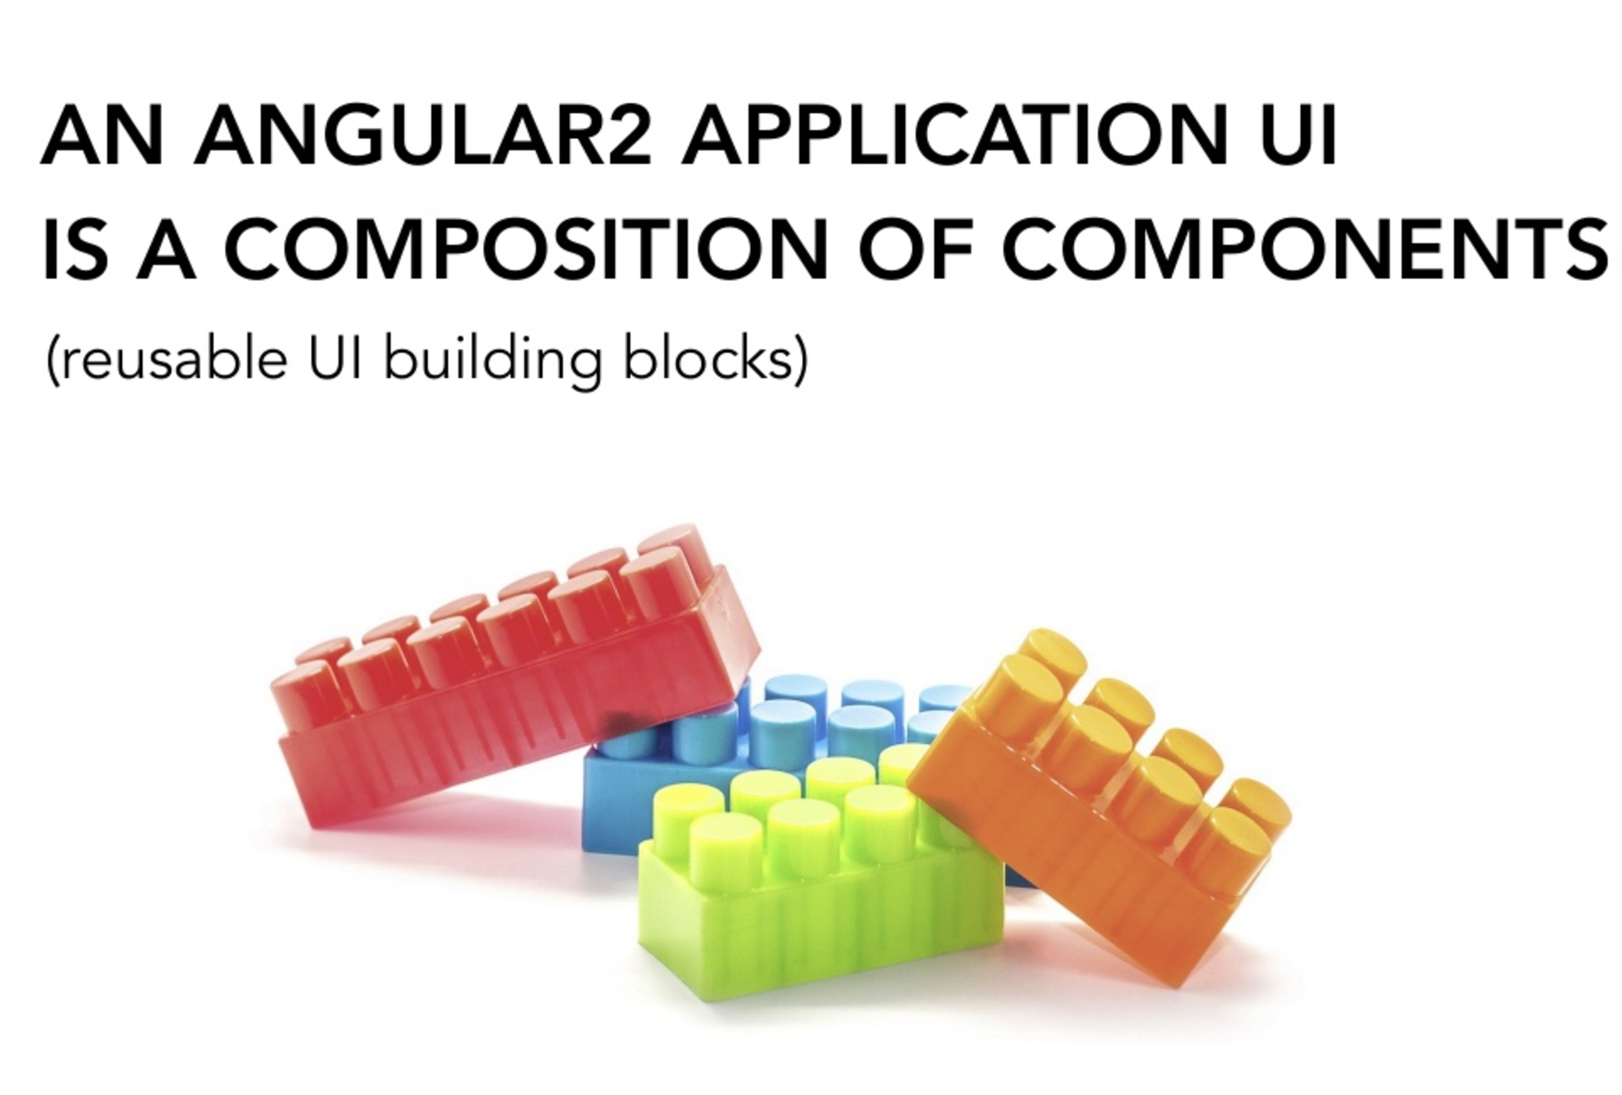

Slide 18
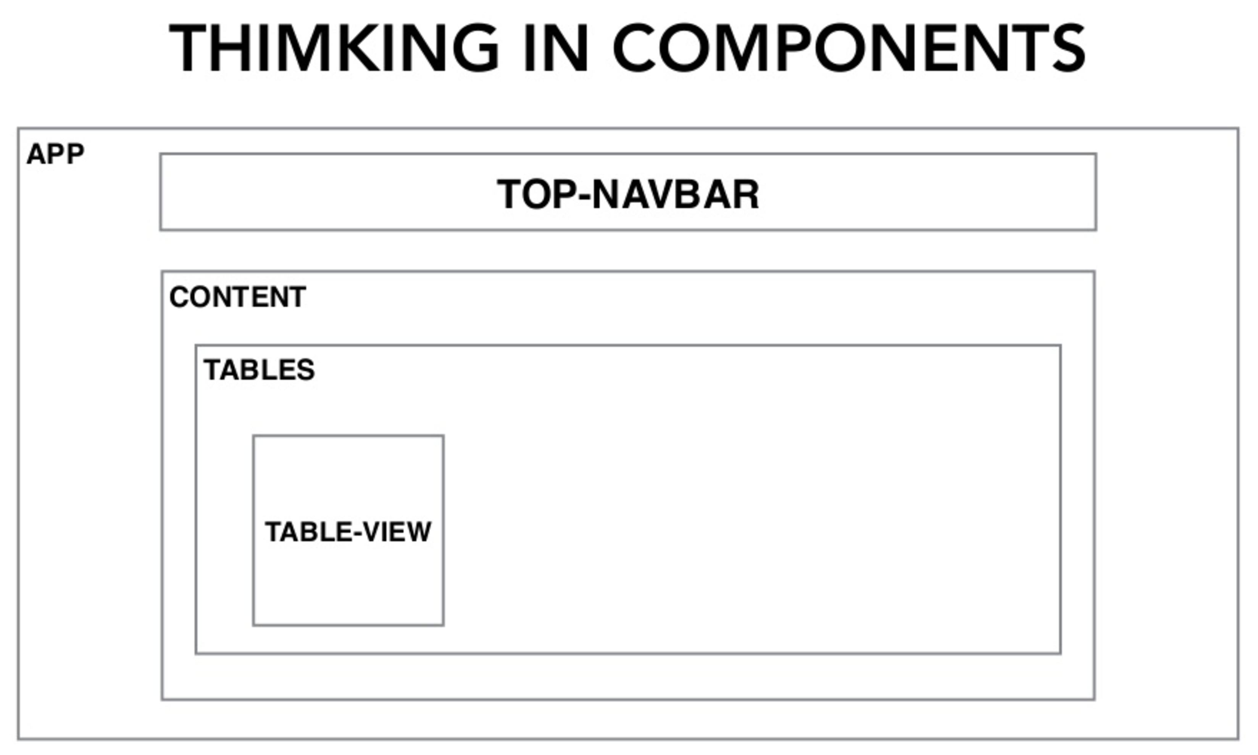

Slide 19
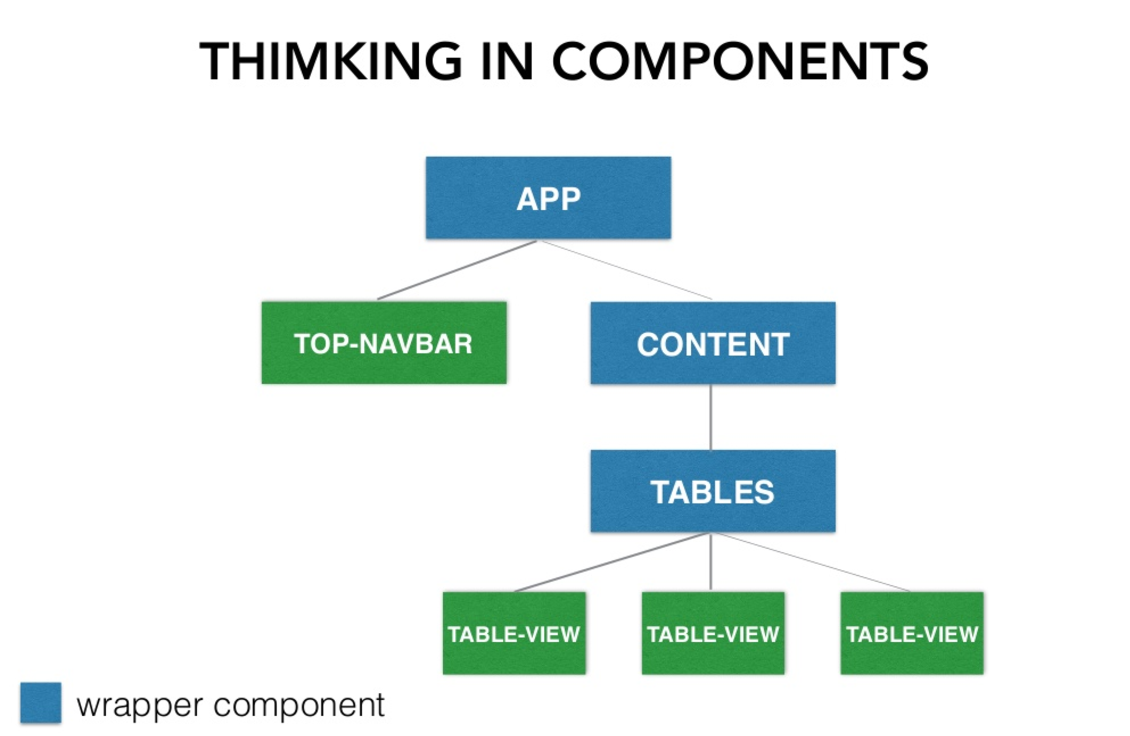

Slide 20
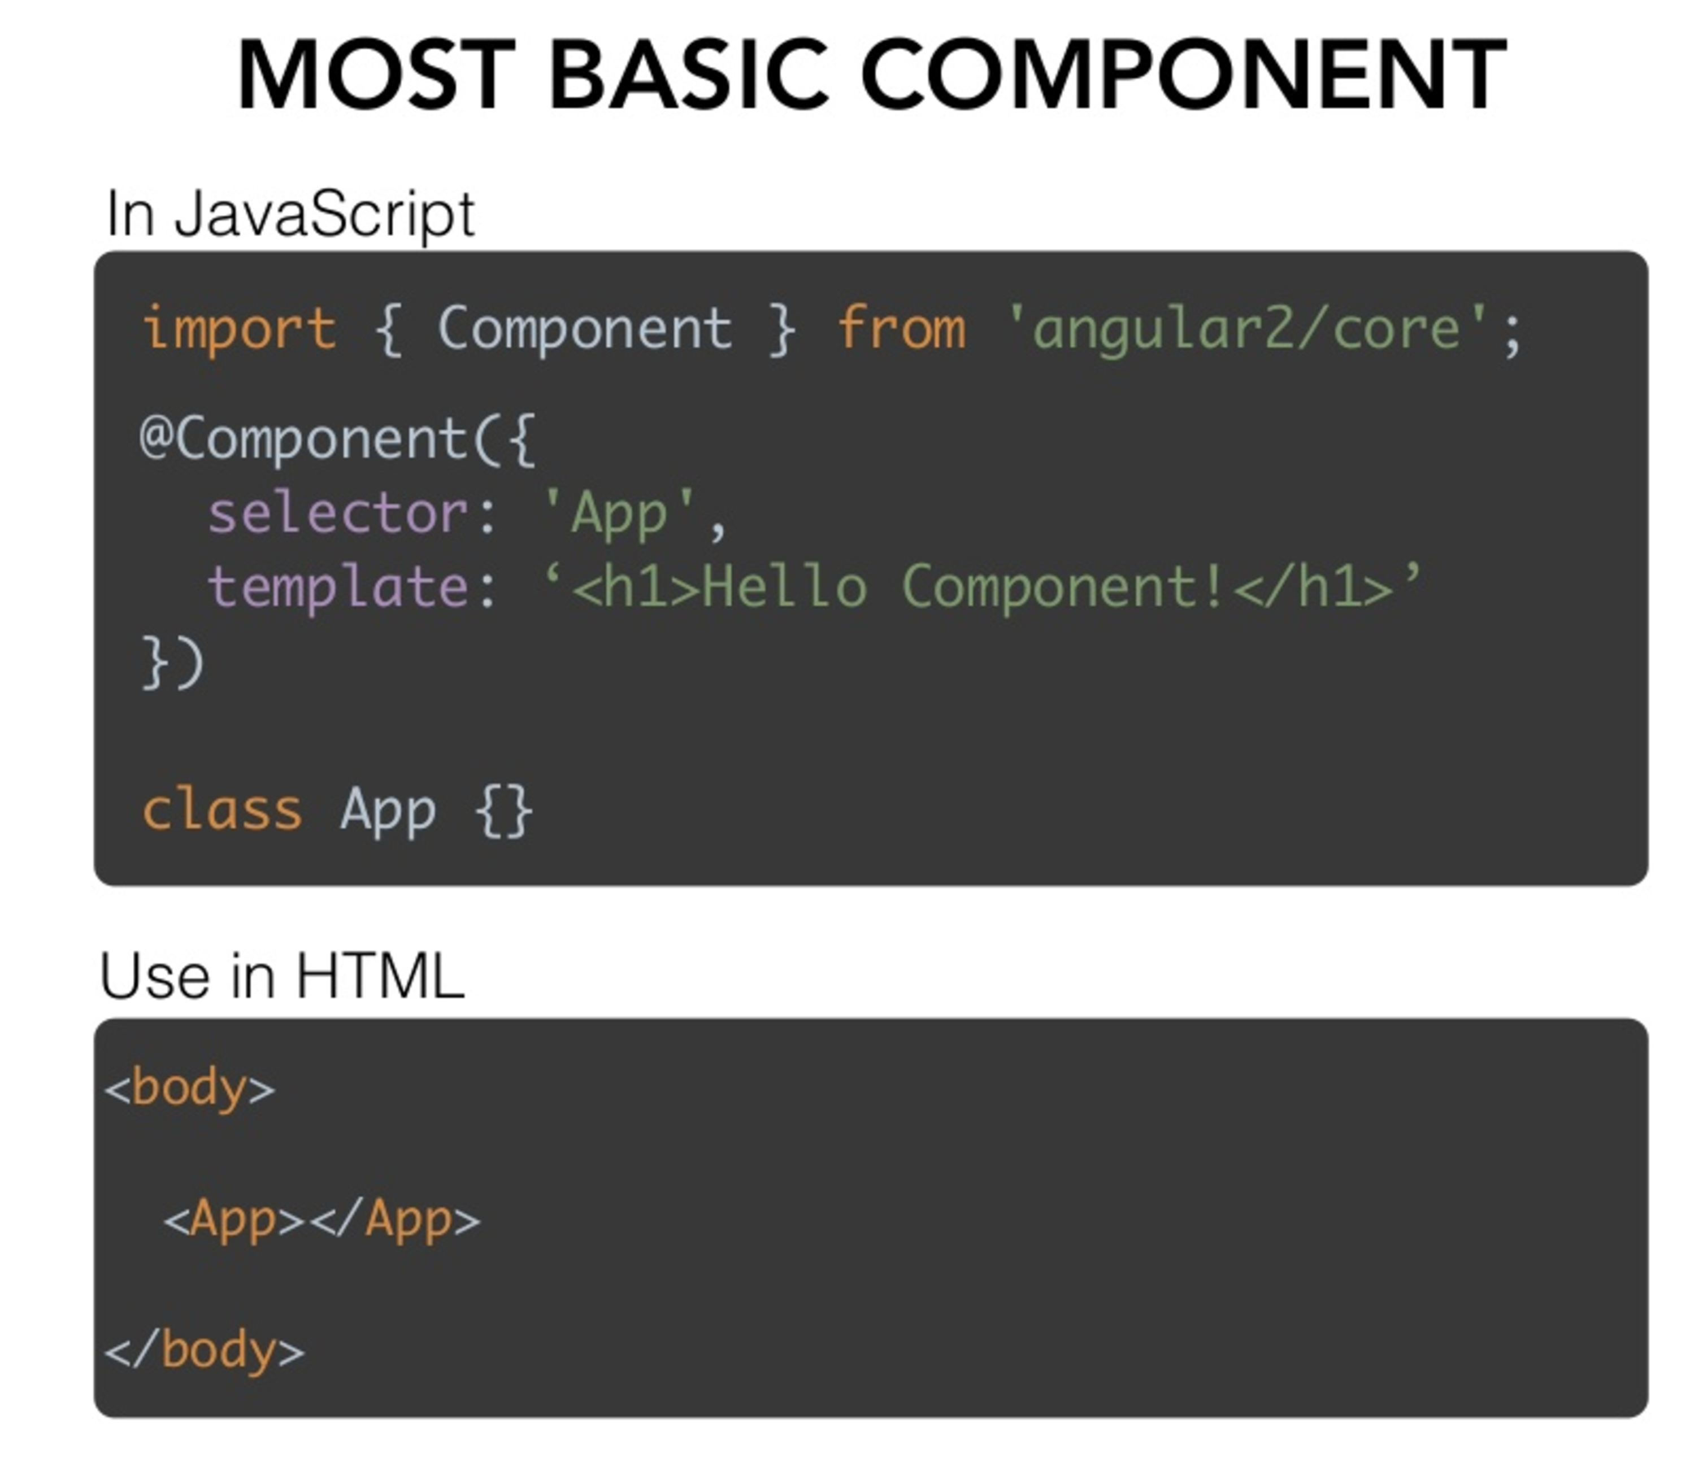

Slide 21
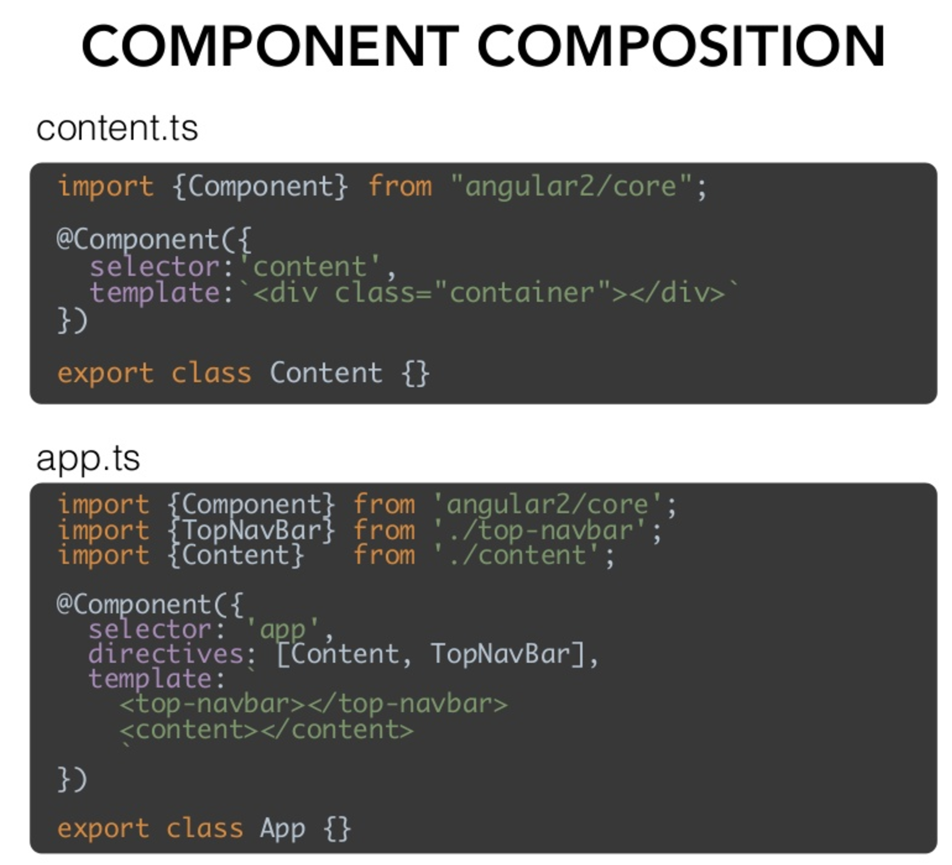

Slide 22
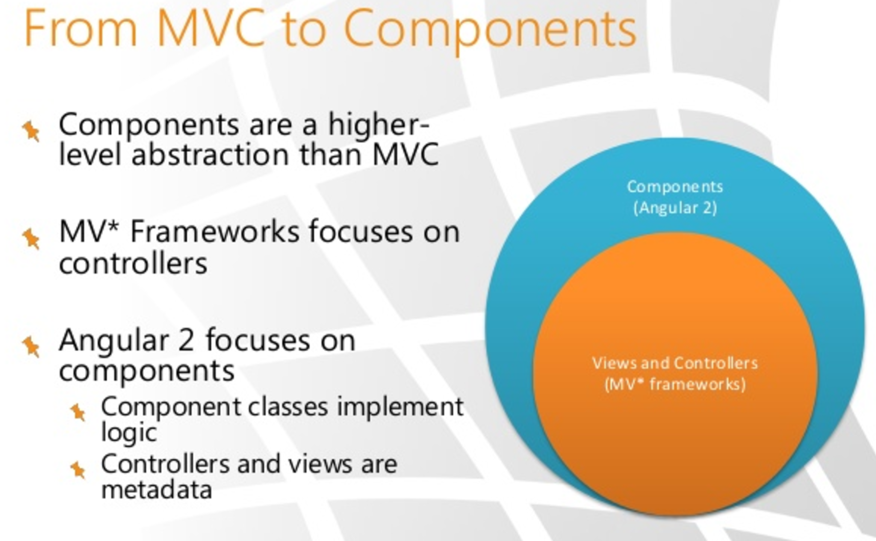

Slide 23
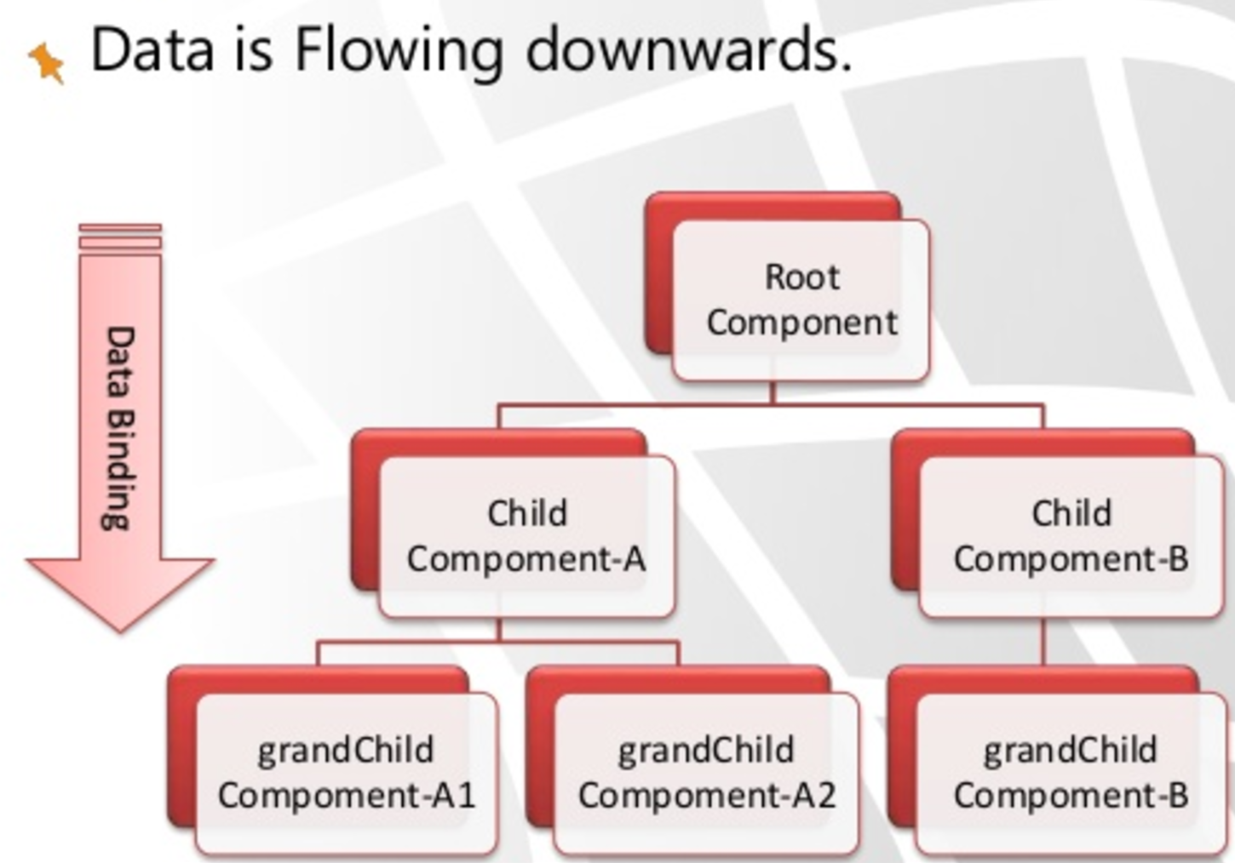

Slide 24
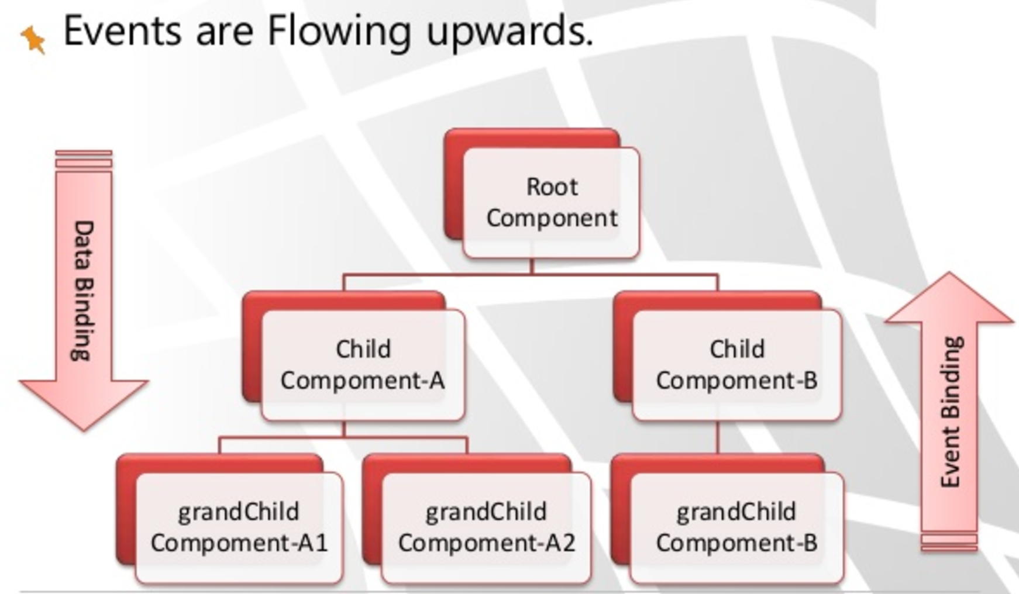

Slide 25
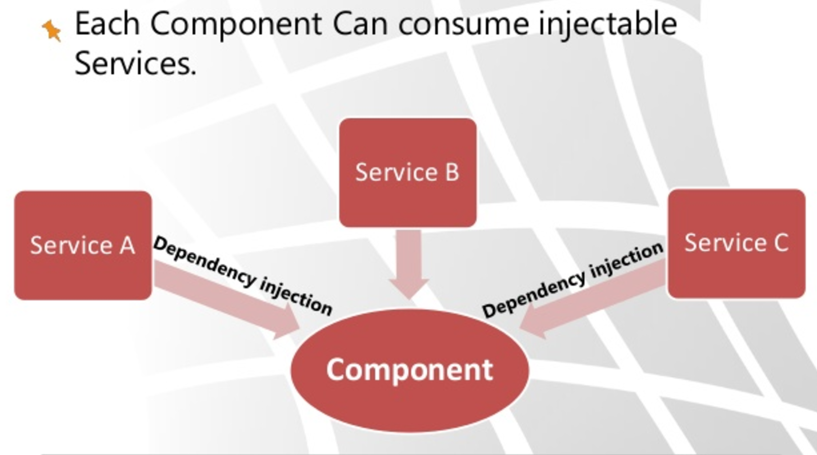

Slide 26
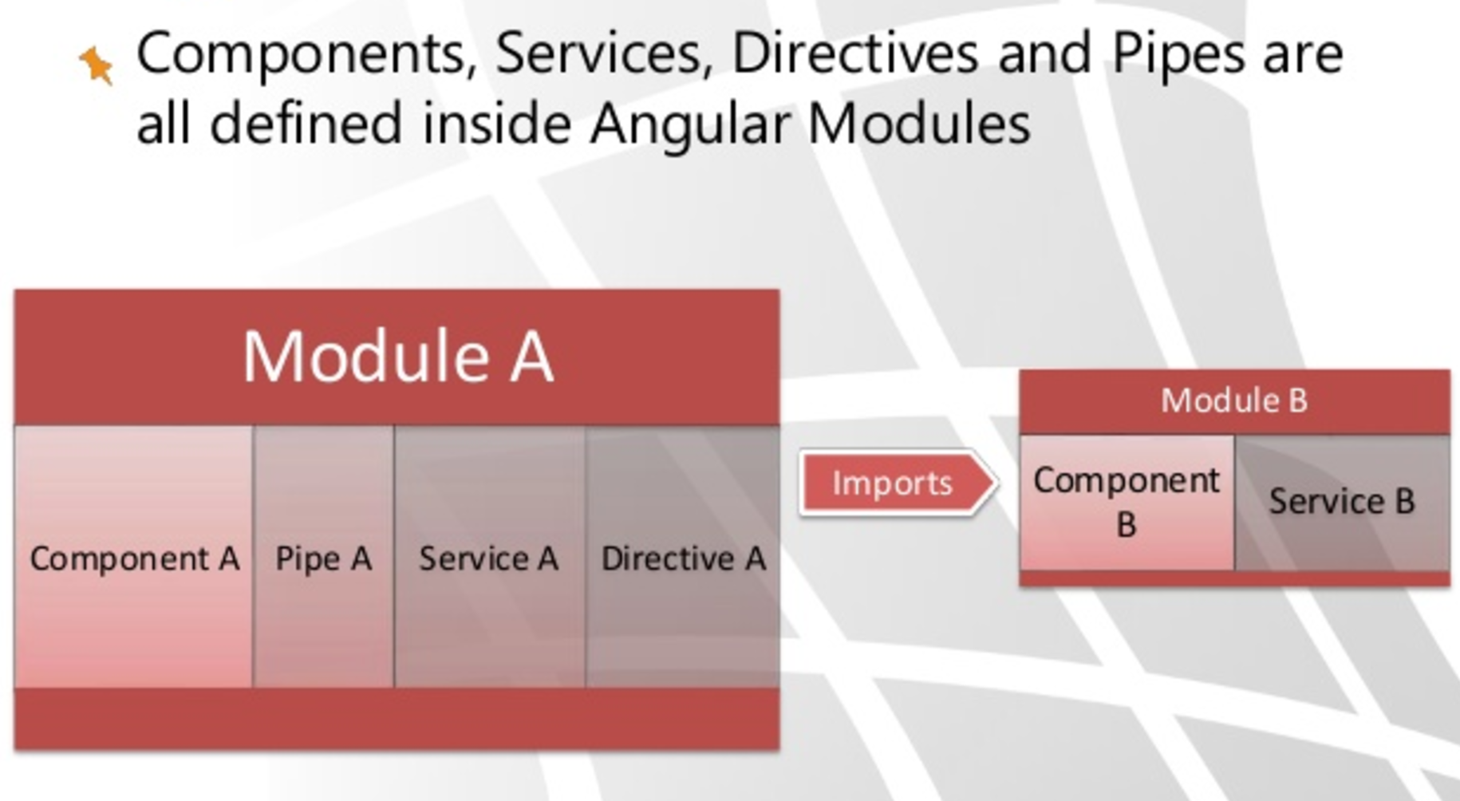

Slide 27

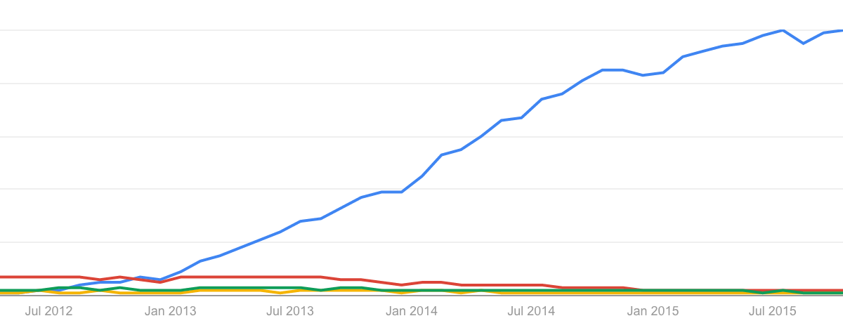
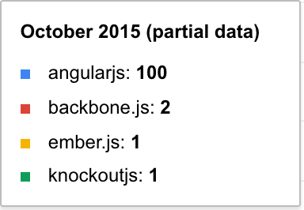
AngularJS interest

Slide 28
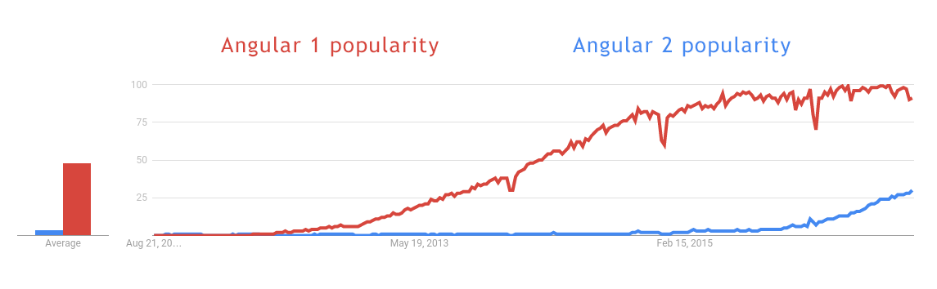

Slide 29
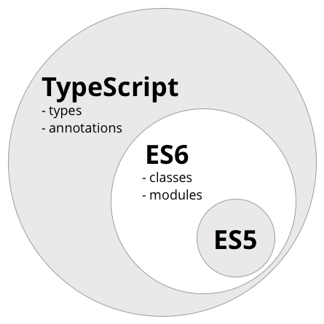

Slide 30
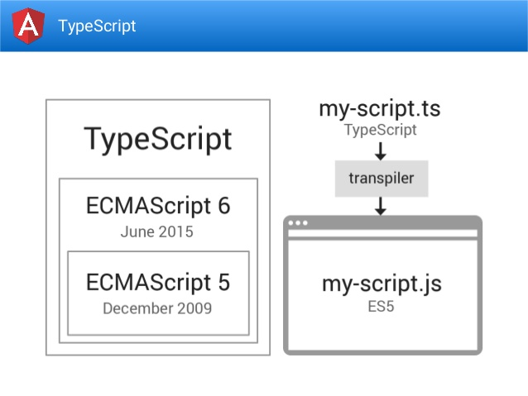

Slide 31
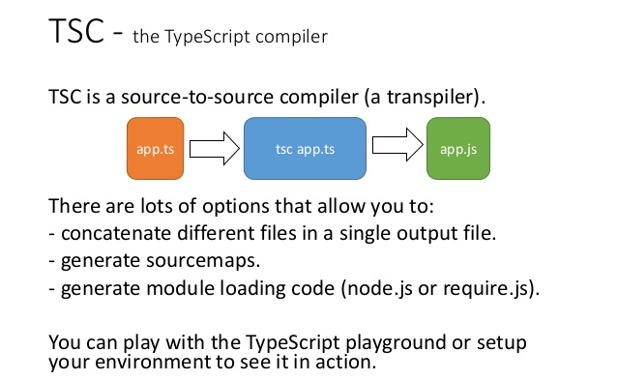

Slide 32
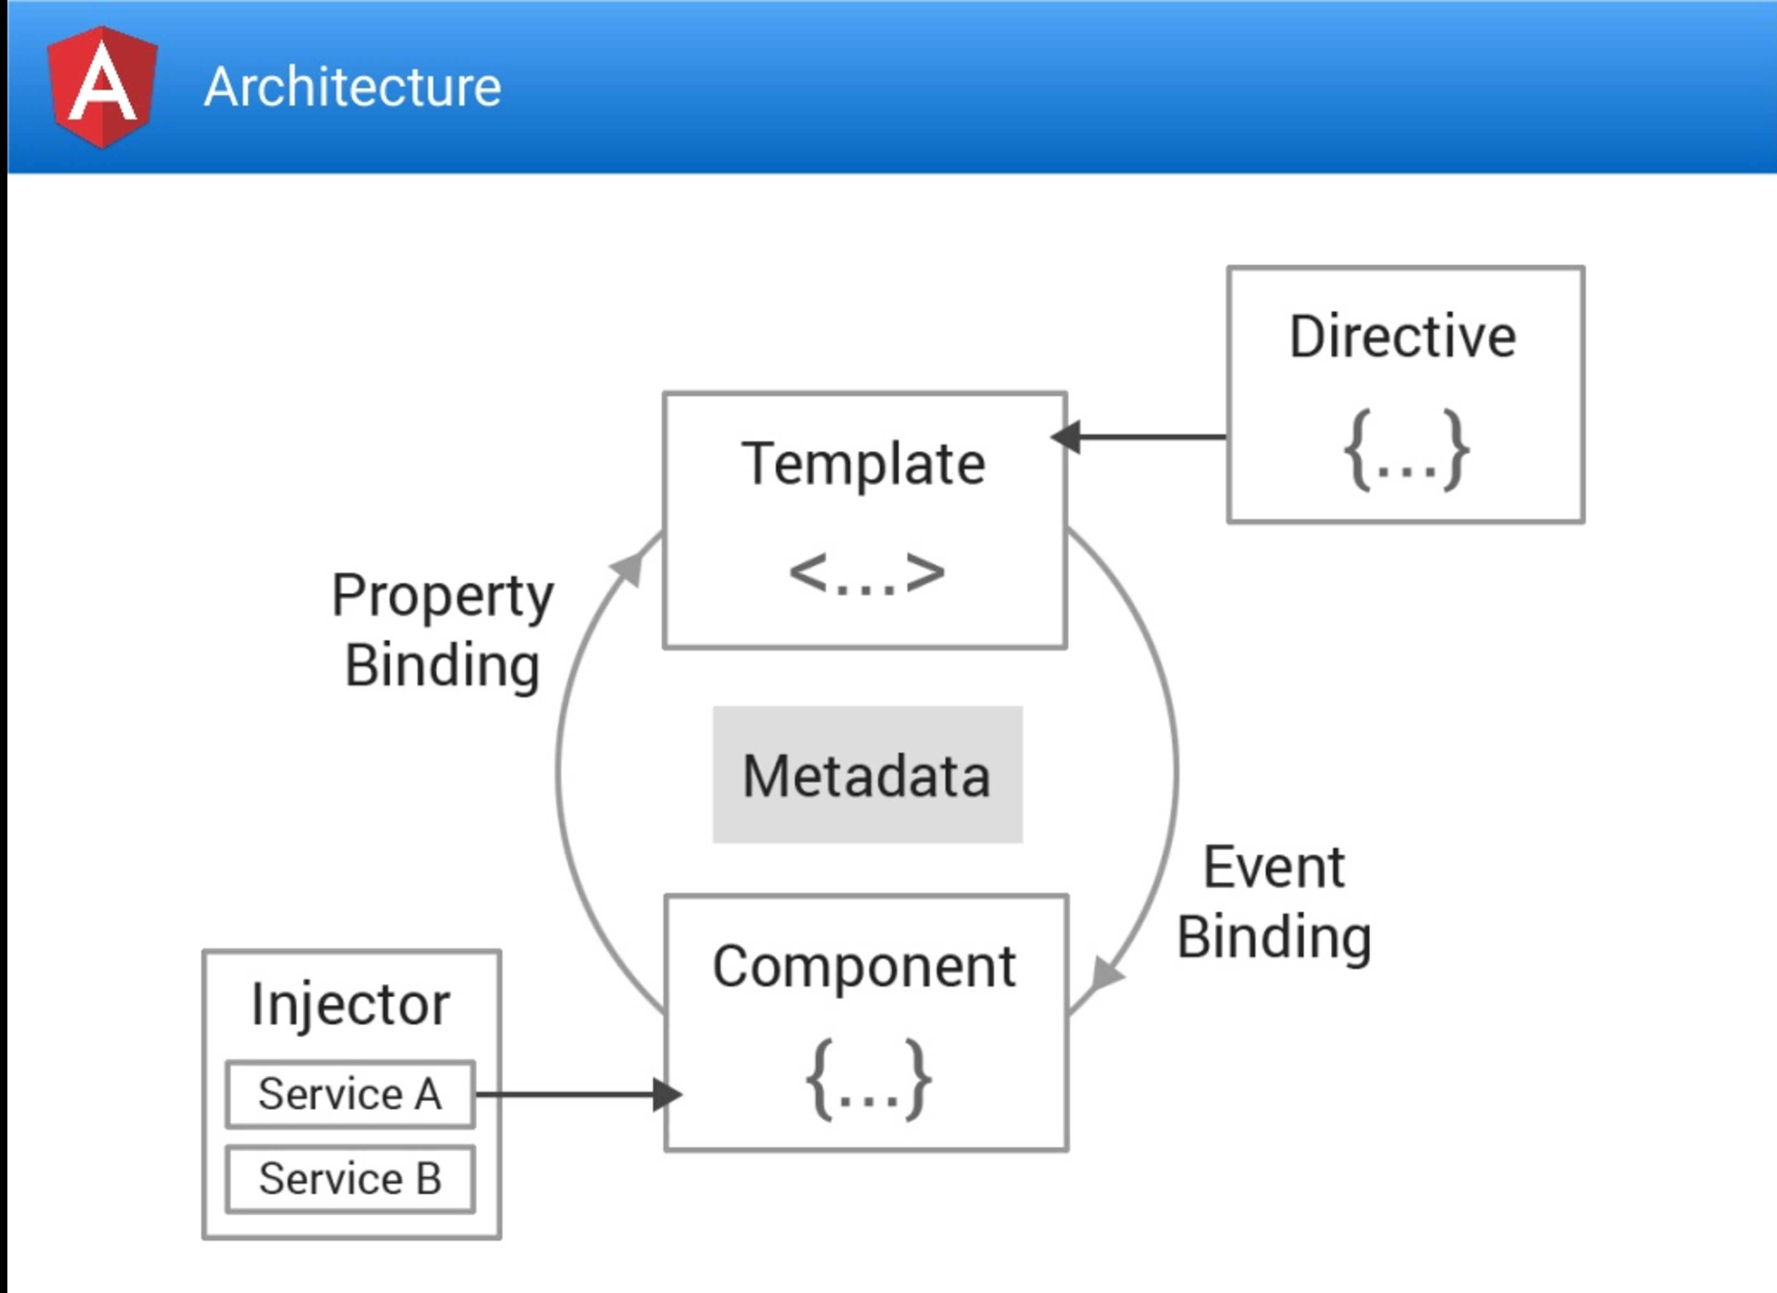

Slide 33
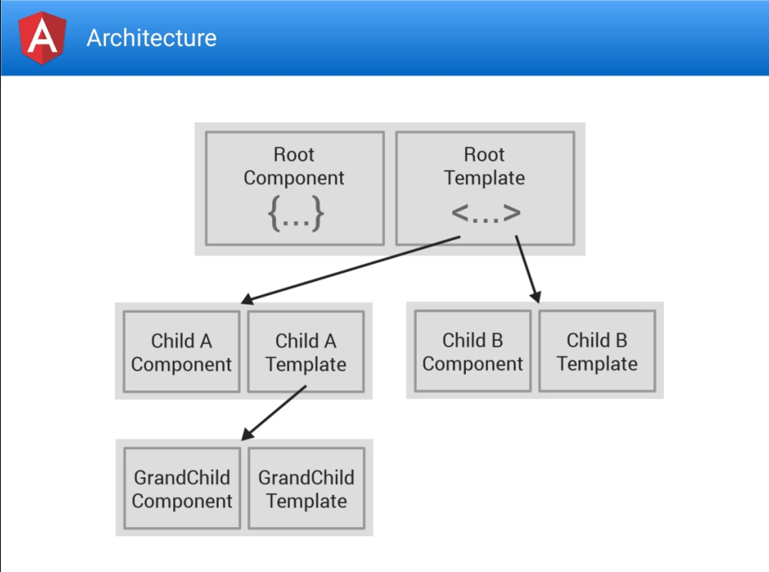

Slide 34
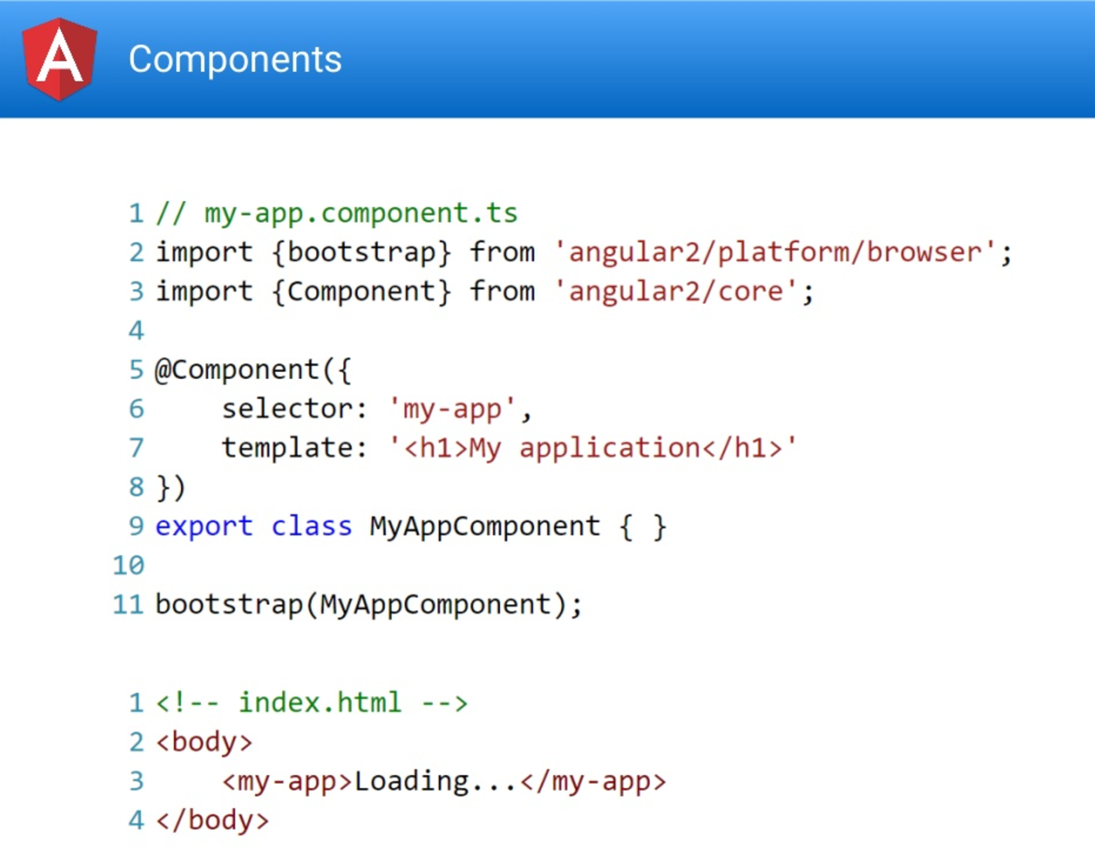

Slide 35
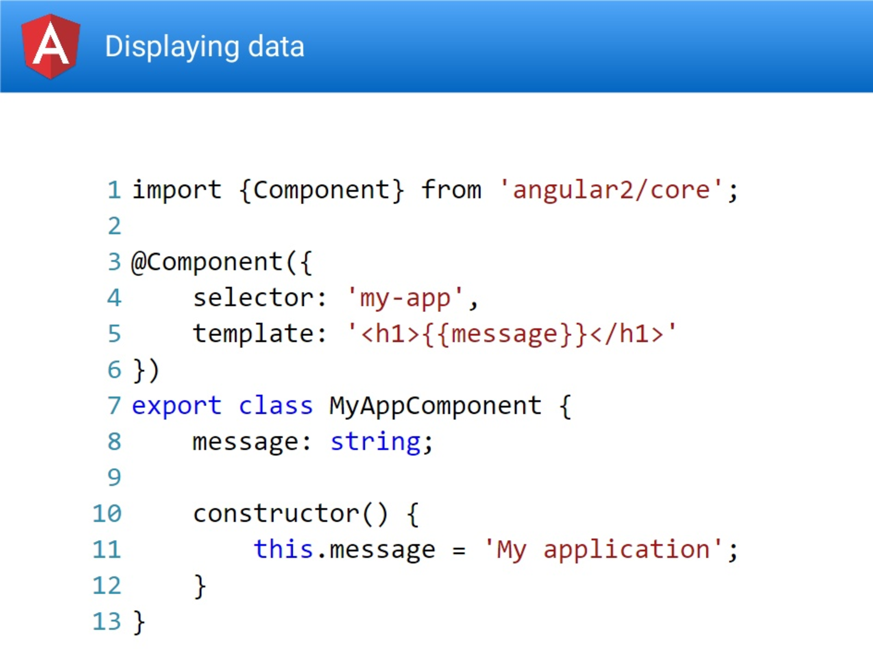

Slide 36
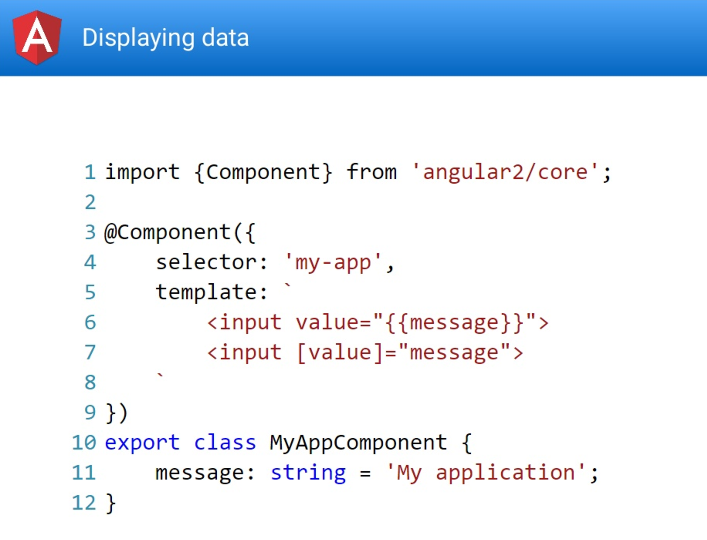

Slide 37
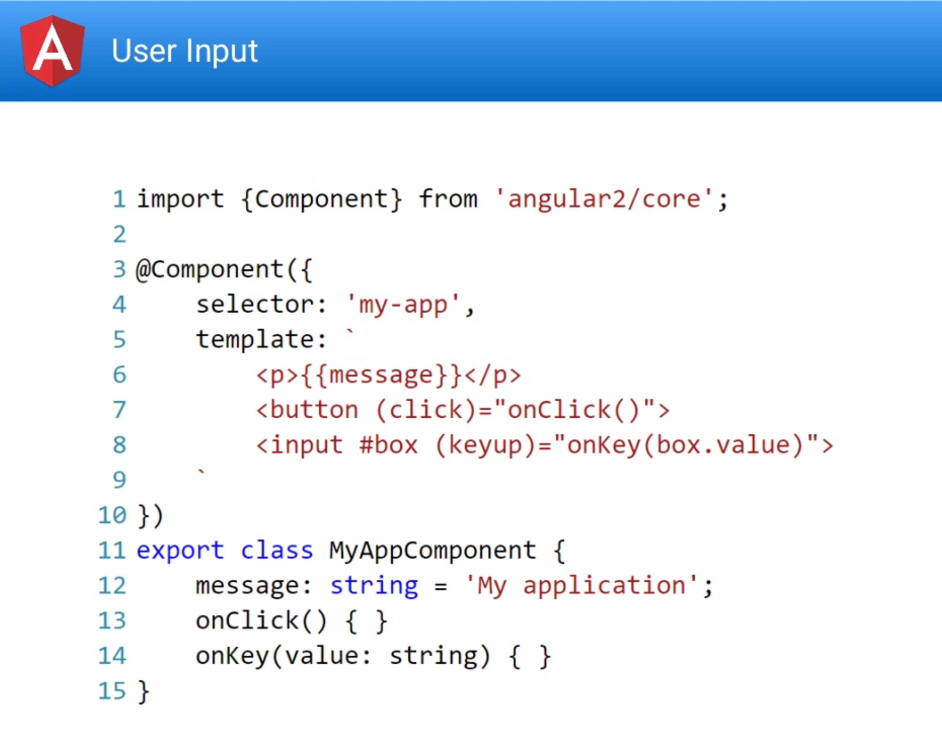

Slide 38
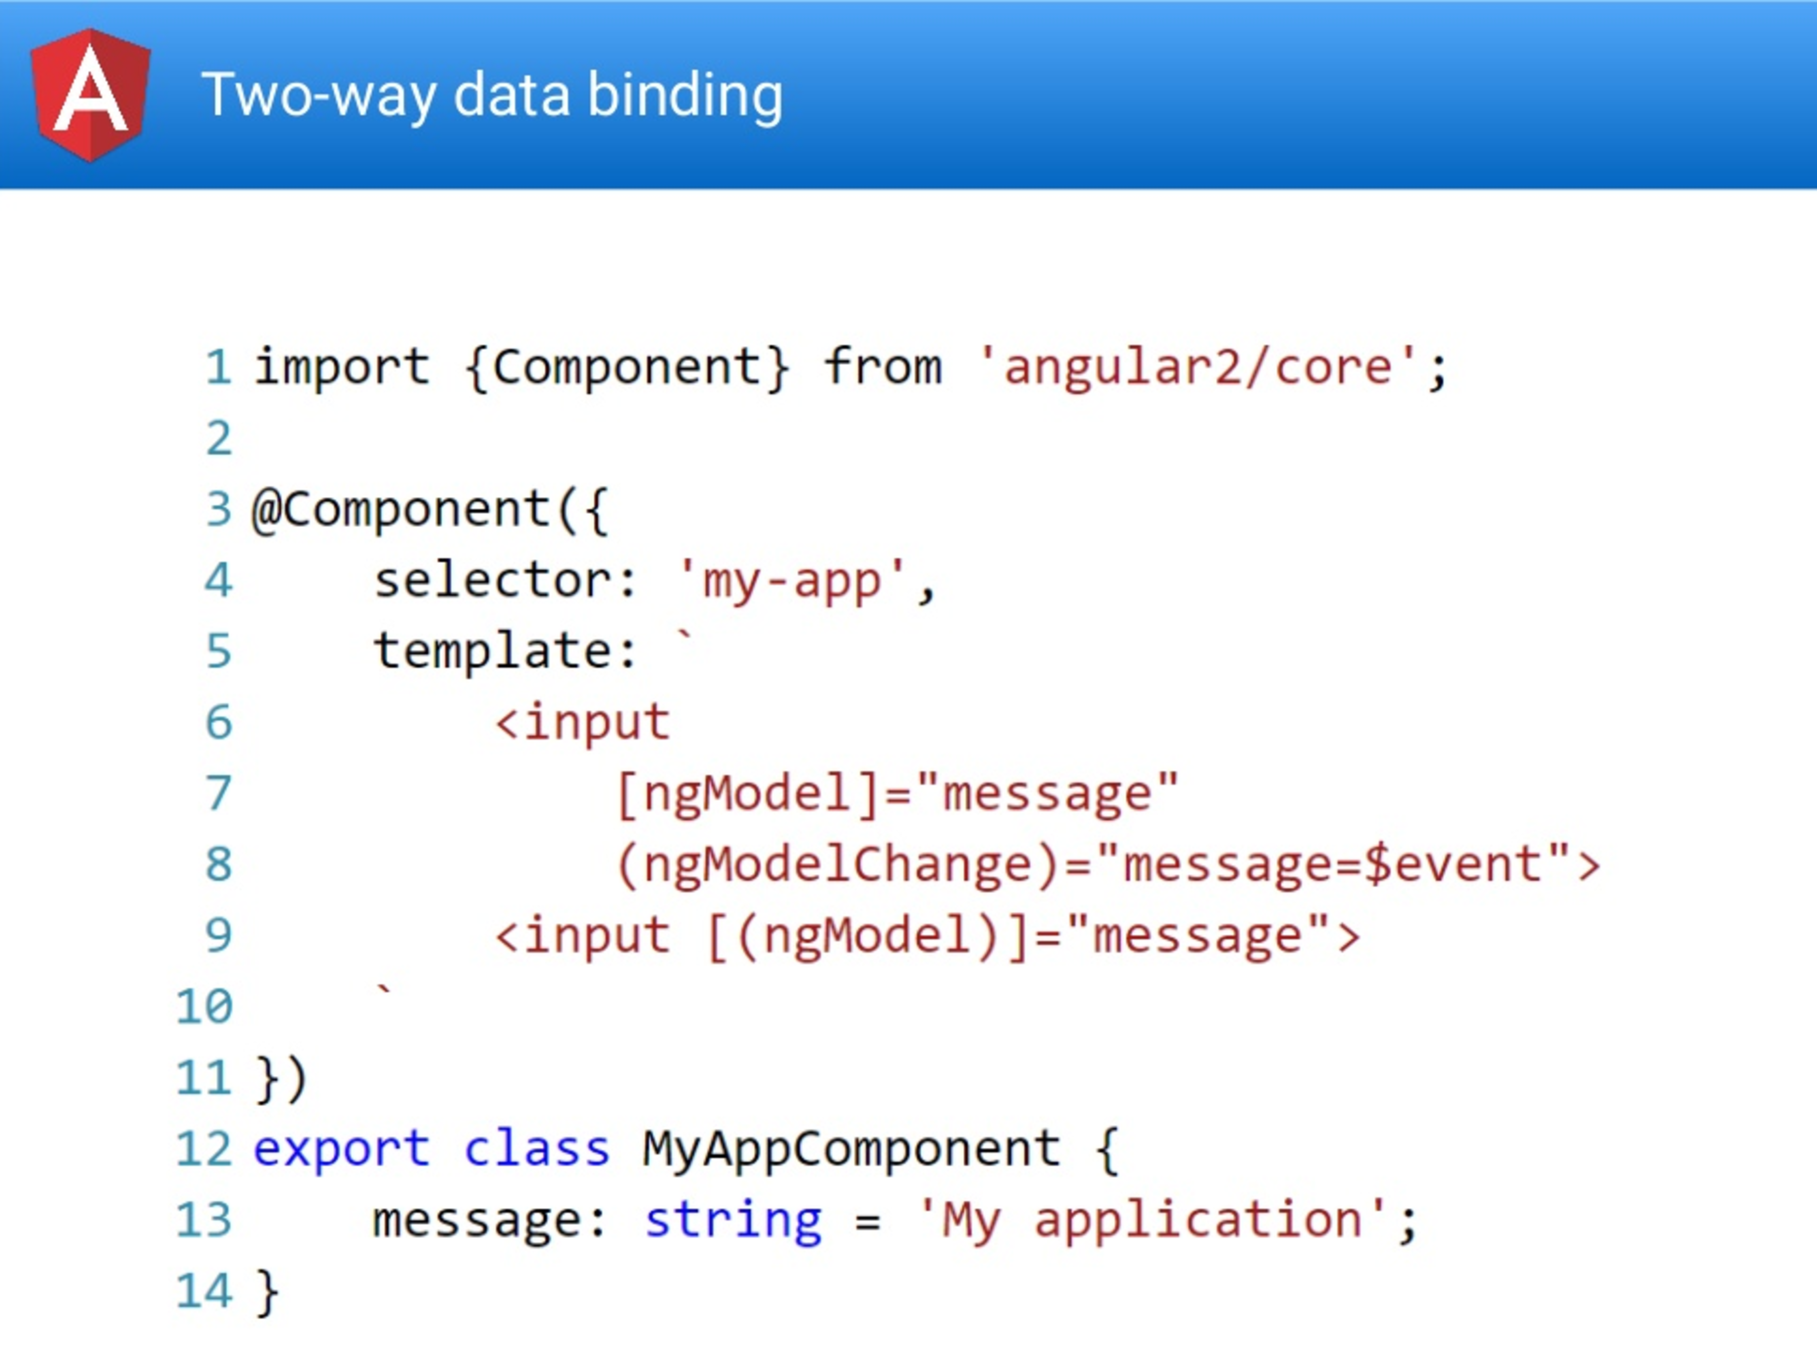

Slide 39
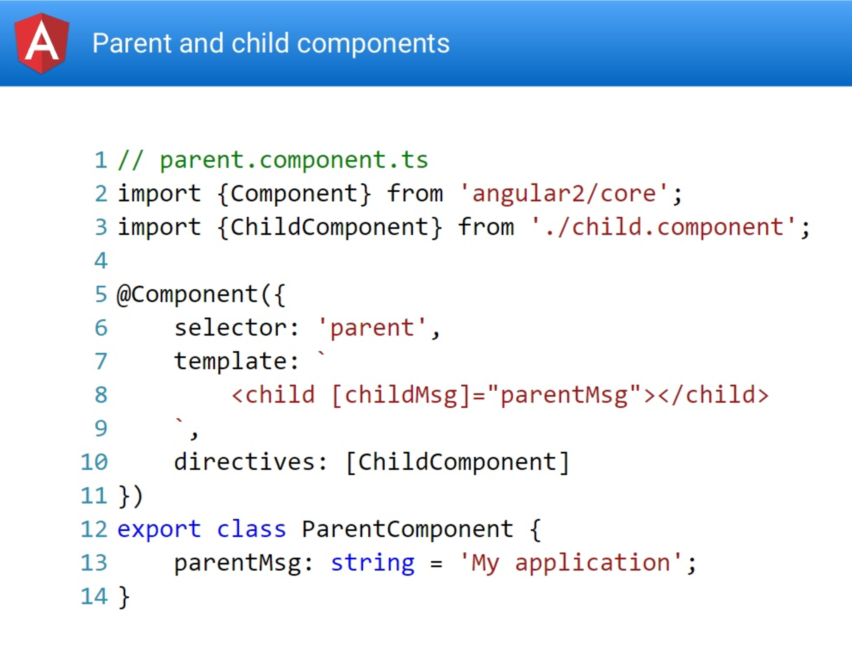

Slide 40
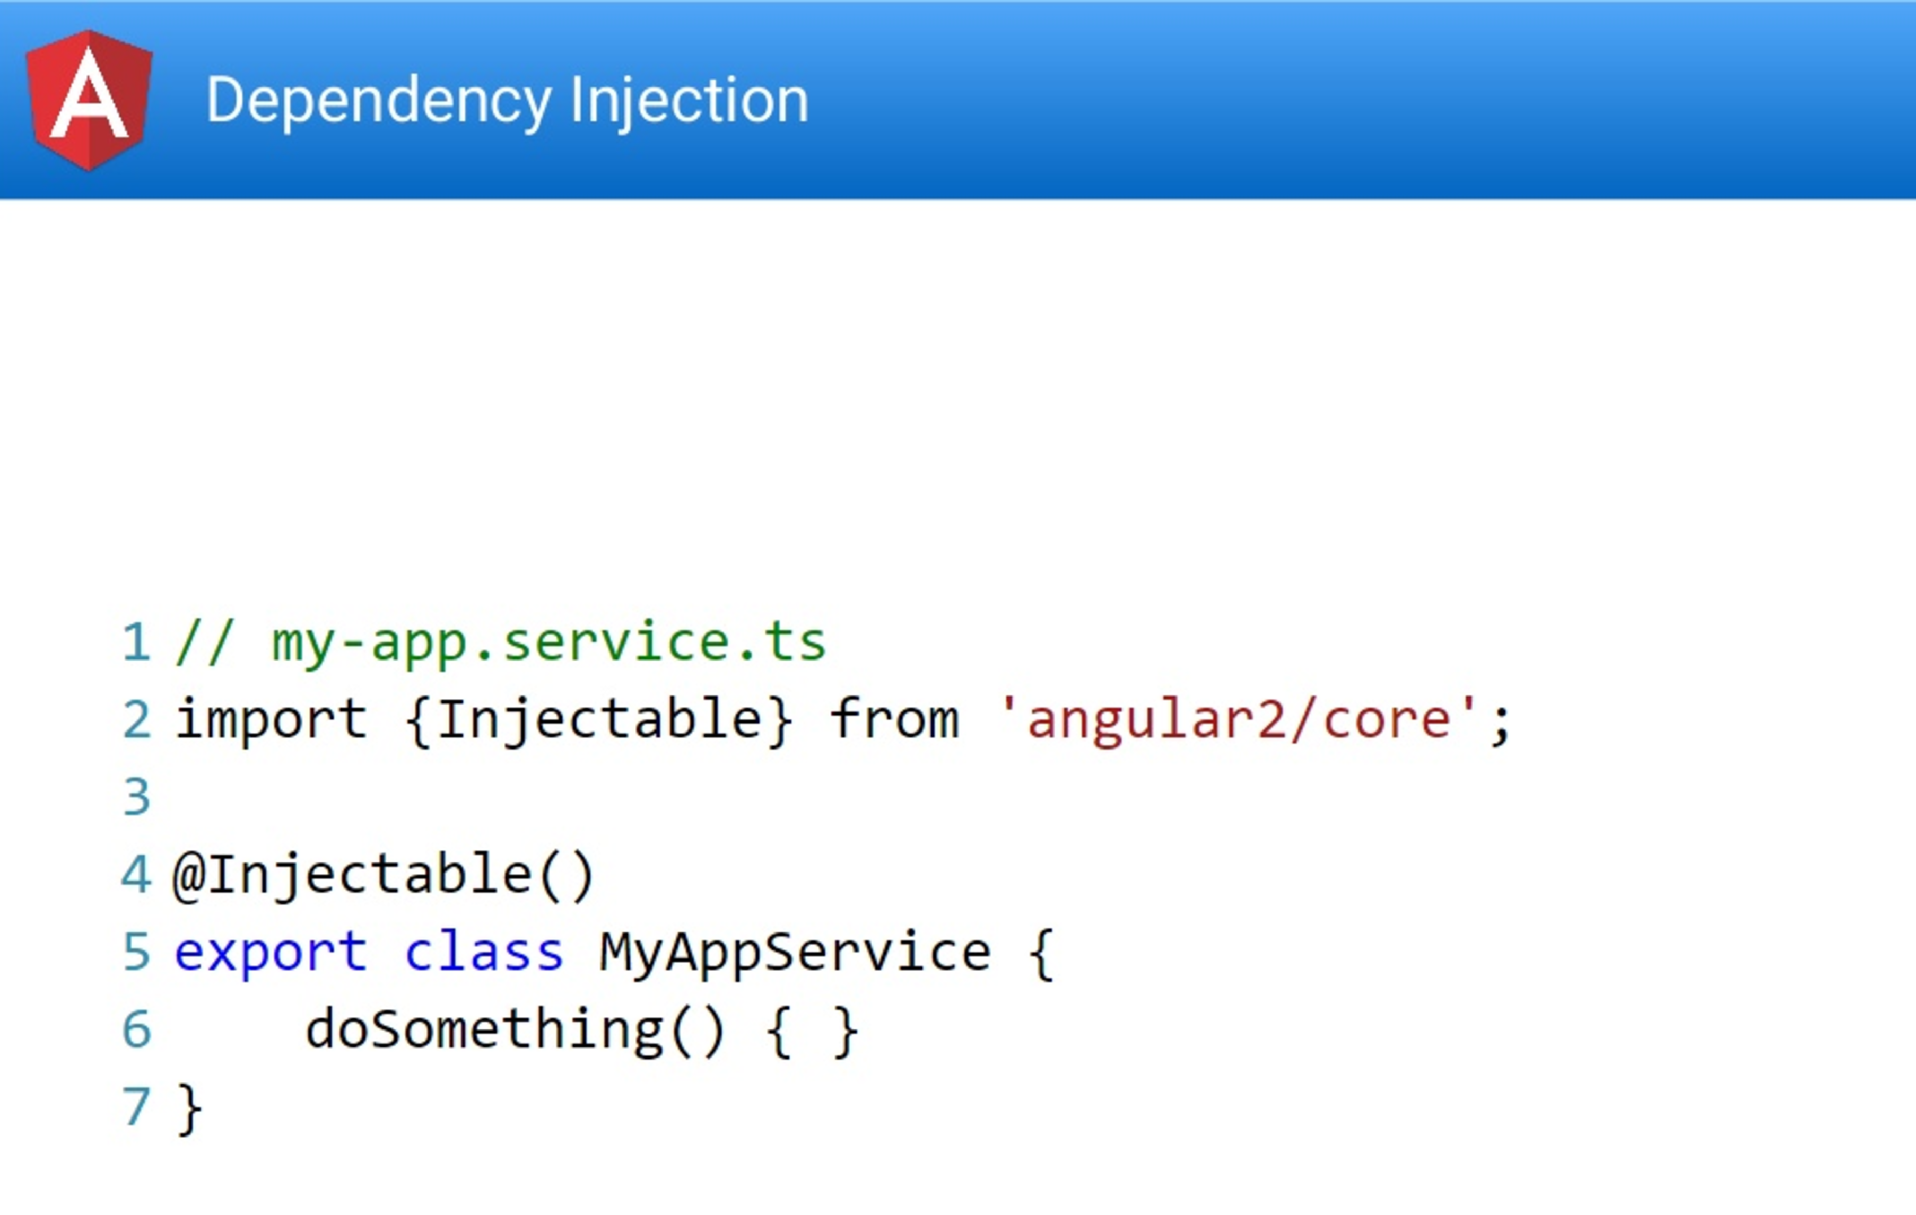

Slide 41
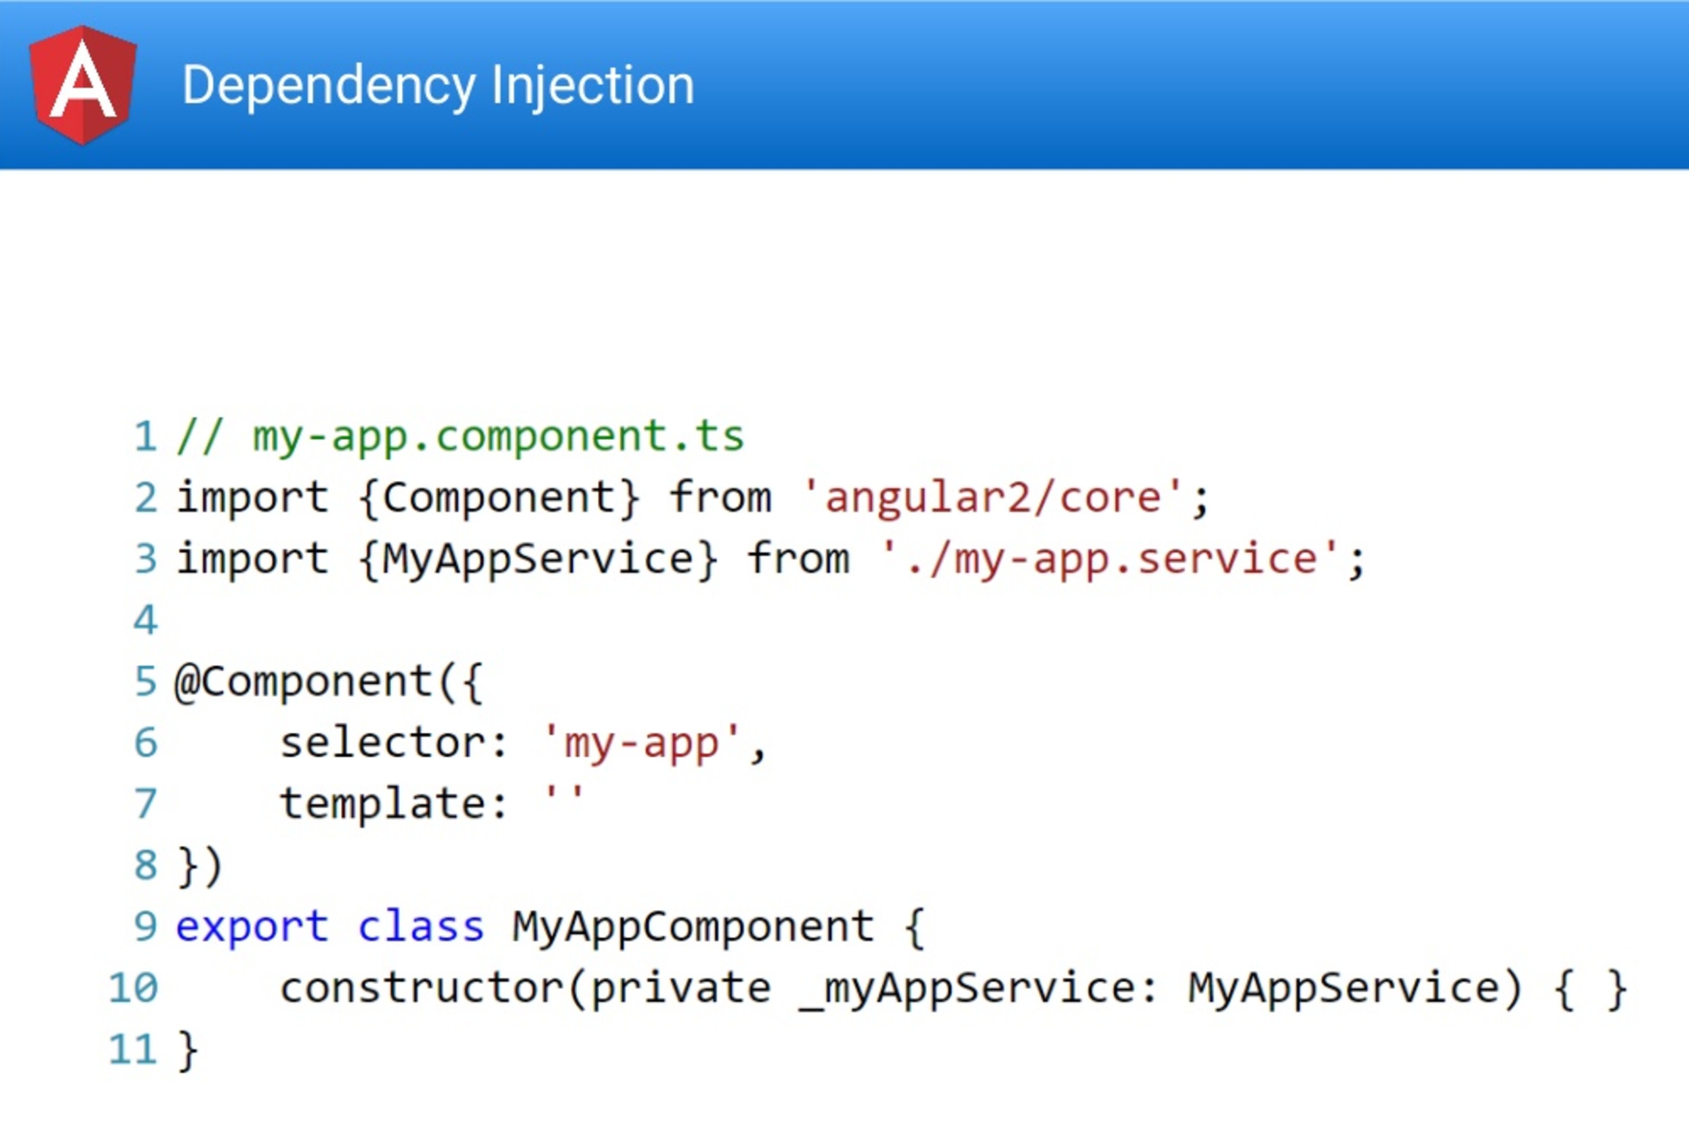

Slide 42
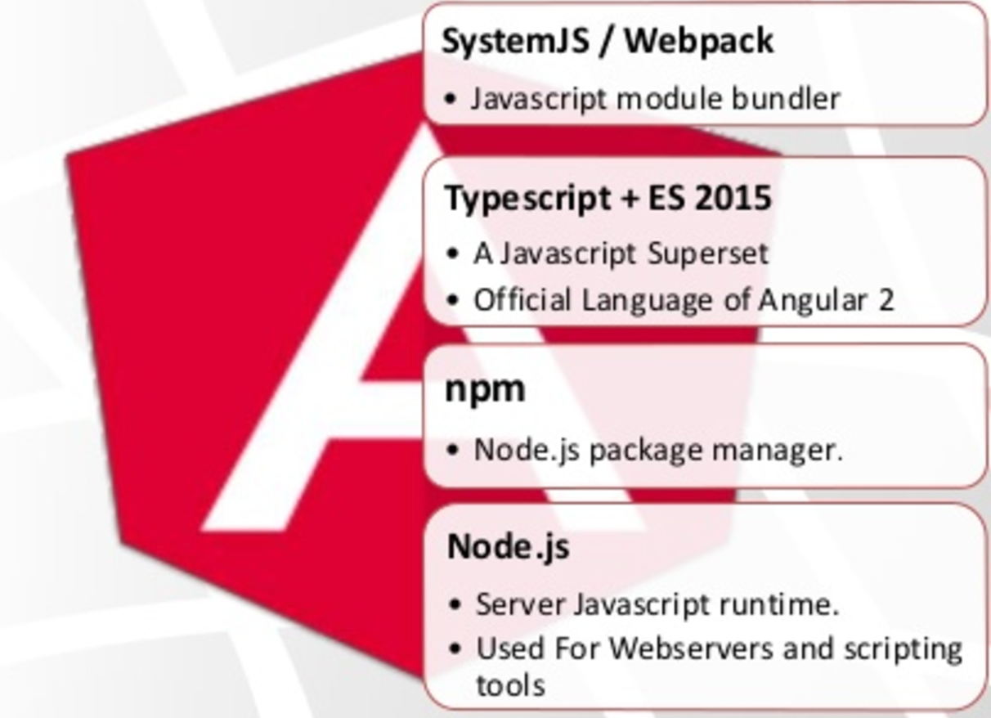
Angular 2 development environment

Slide 43
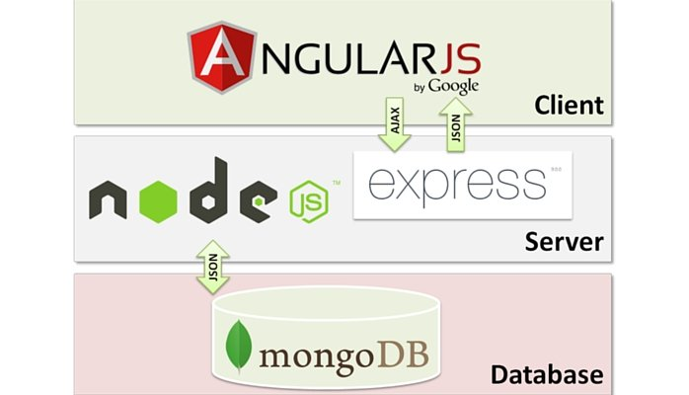
Mean stack

Slide 44
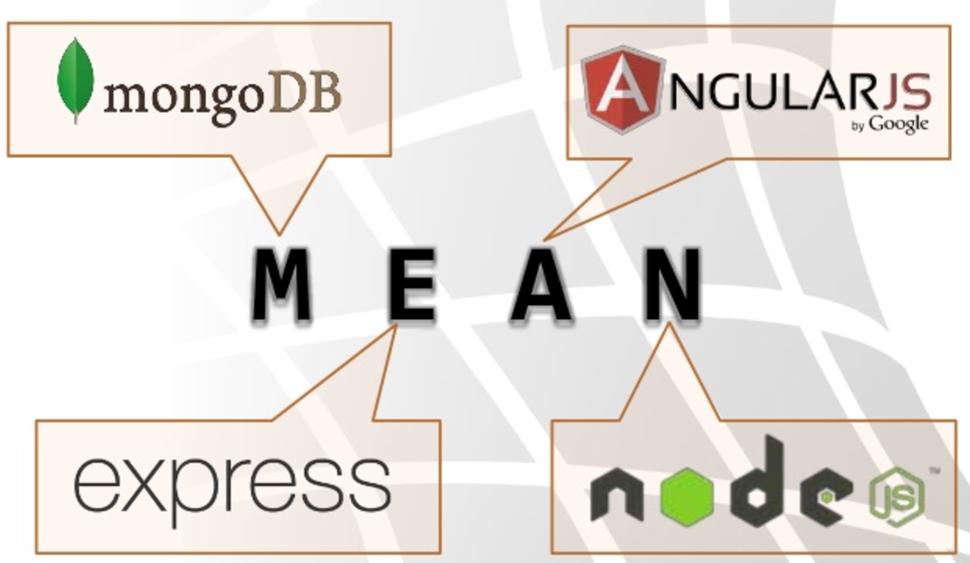
Mean stack

Slide 45
Thank you and have a good training!

